Slide 1
1Q 2022 Dade-Broward County Market Report
Proprietary Information
Proprietary Information
Proprietary Information
1Q 2022
Dade-Broward County
Market Report
Single Family Detached Residences / Condo/Townhome Residences
Presented by Natascha Tello

Slide 2
1Q 2022 Dade-Broward County Market Report
Proprietary Information
Proprietary Information
Proprietary Information
Current Market Overview
Understanding three views of the current market allows Buyers to maximize their ability to evaluate properties, receiving the highest value in their home search and Sellers to position their property to maximize money in their pocket while minimizing time on market:
Macro View: National Market
National Media Coverage
Metro View: Broward County Markets
Quarterly SEFMLS Market Report
Micro View: Your Community
Comparative Market Analysis
Broward County Single Family Detached Residences/ Condo/Townhouse Residences
Provided By Chart Master Services, LLC exclusively for Keller Williams Realty
Dade-Broward County Single Family Detached Residences/ Condo/Townhouse Residences
Provided By Chart Master Services, LLC exclusively for Keller Williams Realty

Slide 3
1Q 2022 Miami-Dade County Market Report
Proprietary Information
YTD Sales Lower (-10.9%) vs. Last Year
Median Sales Price Higher by +14.0% vs. Last Year
Median S/OLP = 98.2%, up by +1.7 Points vs. Last Year
Median DOM at 57 days, -16.2% vs. Last Year
Dade County Single Family Detached Residences
Provided By Chart Master Services, LLC exclusively for Keller Williams Realty

Slide 4
1Q 2022 Broward County Market Report
Proprietary Information
YTD Sales Down by -15.8% vs. Last Year
Median Sales Price Up by +20.9% vs. Last Year
Median S/L = 100.0%, Up +2.4 Points vs. Last Year
Median DOM at 31, Down -45.6% vs. Last Year
Broward County Single Family Detached Residences
Provided By Chart Master Services, LLC exclusively for Keller Williams Realty

Slide 5
1Q 2022 Miami-Dade County Market Report
Proprietary Information
YTD Sales Higher (16.1%) vs. Last Year
Median Sales Price Up by +27.9% vs. Last Year
Median S/OLP = 97.1%, up by +4.0 Points vs. Last Year
Median DOM at 82, Down by -32.2% vs. Last Year
Dade County Condo/Townhouse Residences
Provided By Chart Master Services, LLC exclusively for Keller Williams Realty

Slide 6
1Q 2022 Broward County Market Report
Proprietary Information
YTD Sales Down by -2.6% vs. Last Year
1Q Median Sales Price Up by +15.9% vs. Last Year
Median S/L = 98.1%, up +3.2% vs. Last Year
Median DOM at 41 days, Down by -49.4% vs. Last Year
Broward County Condo/Townhouse Residences
Provided By Chart Master Services, LLC exclusively for Keller Williams Realty

Slide 7
1Q 2022 Miami-Dade County Market Report
Proprietary Information
A supply by price range comparison between March 2022 and March 2021 shows decreases in supply in all price ranges below $4.0M and a -.3 months (-15.0%) decrease overall
Properties are now in a Seller’s Market condition at 1.7 months of supply, overall
Dade County Single Family Detached Residences
Provided By Chart Master Services, LLC exclusively for Keller Williams Realty

Slide 8
1Q 2022 Broward County Market Report
Proprietary Information
A supply by price range comparison between March 2022 and March 2021 shows a decrease of -15.4% (-.2 months) overall to 1.1 months
All price ranges below $4.0M are in a Seller’s Market condition, overall
Broward County Single Family Detached Residences
Provided By Chart Master Services, LLC exclusively for Keller Williams Realty

Slide 9
1Q 2022 Miami-Dade County Market Report
Proprietary Information
A supply by price range comparison between March 2022 and March 2021 shows sharp decreases across these price ranges
All of these 8 segments decreased sharply in supply vs. the same period last year
Price ranges below $4.0M< are now in a Seller’s Market condition while the overall market at 2.2 months of supply was down by -63.3% (-3.8 months) from last year and in a Seller’s Market condition
Dade County Condo/Townhouse Residences
Provided By Chart Master Services, LLC exclusively for Keller Williams Realty

Slide 10
1Q 2022 Broward County Market Report
Proprietary Information
A supply by price range comparison between March 2022 and March 2021 shows that the overall supply dropped by 1.7 months compared to last year, to a very low 1.3 months of supply
A overall Seller’s Market now exists in all price ranges
Broward County Condo/Townhouse Residences
Provided By Chart Master Services, LLC exclusively for Keller Williams Realty

Slide 11
1Q 2022 Miami-Dade County Market Report
Proprietary Information
The Covid-19 pandemic impact began clearly impacting closed sales during April-May 2020 with the low point occurring during May, likely reflecting fewer contracts written beginning in March
A rebound appeared after 2Q 2020 with pent-up demand surfacing to increase monthly sales substantially even into early 2021
March 2022 sales will increase after all closings have been entered into the system
Dade County Single Family Detached Residences
Provided By Chart Master Services, LLC exclusively for Keller Williams Realty

Slide 12
1Q 2022 Broward County Market Report
Proprietary Information
2022 sales were belowthose of the pandemic-impacted period during 1Q 2021
Sales for 1Q 2022 should increase somewhat when lagged closings are processed into the system
Broward County Single Family Detached Residences
Provided By Chart Master Services, LLC exclusively for Keller Williams Realty

Slide 13
1Q 2022 Miami-Dade County Market Report
Proprietary Information
Sales were rising in the first 3 months of 2021 continuing the bounce created by the 2020 pandemic
This year, sales January and February sales were much higher than last year and March sales should rise somewhat after lagged closings have been processed into the system
Dade County Condo/Townhouse Residences
Provided By Chart Master Services, LLC exclusively for Keller Williams Realty

Slide 14
1Q 2022 Broward County Market Report
Proprietary Information
The pandemic-related drop in sales is dramatically shown in monthly sales during 2Q 2021, setting up very large percentage increases in several following periods
2022 monthly sales may now be returning to more normal, seasonal levels
March sales will still increase somewhat after lagged closings are processed
Broward County Condo/Townhouse Residences
Provided By Chart Master Services, LLC exclusively for Keller Williams Realty

Slide 15
1Q 2022 Dade County Area Comparison Report--
Proprietary Information
Dade & Broward County Single Family Detached Residences
Provided By Chart Master Services, LLC exclusively for Keller Williams Realty

Slide 16
1Q 2022 Dade County Area Comparison Report--
Proprietary Information
Dade & Broward County Condo/Townhouse Residences
Provided By Chart Master Services, LLC exclusively for Keller Williams Realty

Slide 17
1Q 2022 Dade County Area Comparison Report--
Proprietary Information
Single Family Detached Residences
Provided By Chart Master Services, LLC exclusively for Keller Williams Realty

Slide 18
1Q 2022 Dade County Area Comparison Report--
Proprietary Information
Condo/Townhouse Residences
Provided By Chart Master Services, LLC exclusively for Keller Williams Realty

Slide 19
1Q 2022 Miami-Dade County Market Report
Proprietary Information
The 1Q 2022 median DOM segmented by price range shows that even though the overall median fell by -16.2% there were even more significant changes in some price ranges
The median of DOM increased in only 1 of these 8 price ranges
Dade County Single Family Detached Residences
Provided By Chart Master Services, LLC exclusively for Keller Williams Realty

Slide 20
1Q 2022 Broward County Market Report
Proprietary Information
The 1Q 2022 median DOM segmented by price range shows that there was a decrease of -45.6% (-26 days) overall with more substantial changes in some price ranges
All of these price ranges had lower median DOM than last year
Broward County Single Family Detached Residences
Provided By Chart Master Services, LLC exclusively for Keller Williams Realty

Slide 21
1Q 2022 Miami-Dade County Market Report
Proprietary Information
Segmenting 1Q 2022 median DOM by price range shows that the overall median decreased by -32.2% while each price range had lower medians of days on market compared to last year
Dade County Condo/Townhouse Residences
Provided By Chart Master Services, LLC exclusively for Keller Williams Realty

Slide 22
1Q 2022 Broward County Market Report
Proprietary Information
Segmenting the median DOM by price range shows that while the overall median was -49.4% lower, larger changes occurred in some price ranges during 1Q 2022
The Median of DOM was lower than last year in 7 of these 8 price ranges 1Q 2022
Broward County Condo/Townhouse Residences
Provided By Chart Master Services, LLC exclusively for Keller Williams Realty

Slide 23
1Q 2022 Miami-Dade County Market Report
Proprietary Information
Failed listings (Expired, cancelled, withdrawn, terminated) are shown here as a percentage of total “finalized” (Expired + Cancelled + Withdrawn + Terminated + Closed) listings
1Q 2022 Failed Listings were slightly lower by -.4 percentage points compared to the same period last year, at 29.6% of finalized listings
Listings usually fail to sell due to overpricing
Dade County Single Family Detached Residences
Provided By Chart Master Services, LLC exclusively for Keller Williams Realty

Slide 24
1Q 2022 Broward County Market Report
Proprietary Information
Failed listings (Expired, cancelled, withdrawn, terminated) are shown here as a percentage of total “finalized” (Expired + Cancelled + Withdrawn + Terminated + Closed) listings
Failed listings as a percent of total finalized listings tend to decline in the first 2 quarterly periods each year, seasonally
1Q 2022 Failed Listings were -1.2 percentage points lower than in the same period last year at 20.9%, remaining at more than 1 of every 5 finalized listings
Listings usually fail to sell due to overpricing
Broward County Single Family Detached Residences
Provided By Chart Master Services, LLC exclusively for Keller Williams Realty

Slide 25
1Q 2022 Miami-Dade County Market Report
Proprietary Information
The opposite of a Closed listing is a Failed listing, one that was rejected by the market, normally due to overpricing
Failed listings (Expired, cancelled, withdrawn, terminated) are shown here as a percentage of total “finalized” listings (Expired + cancelled + withdrawn + terminated + Closed)
Following a higher rate of failed listings in 1Q 2021, 1Q 2022 was lower but remained high at 31.8% of finalized listings which was -12.5 percentage points lower than in the same period last year
Dade County Condo/Townhouse Residences
Provided By Chart Master Services, LLC exclusively for Keller Williams Realty

Slide 26
1Q 2022 Broward County Market Report
Proprietary Information
The opposite of a Closed listing is a Failed listing - one that was rejected by the market, usually due to overpricing
Failed listings (Expired, cancelled, withdrawn) are shown here as a percentage of total “finalized” listings (Expired + cancelled + withdrawn + Closed)
In 1Q 2022, 20.6% of finalized listings failed to sell which was lower (-10.3 percentage points) compared to the same period last year
Broward County Condo/Townhouse Residences
Provided By Chart Master Services, LLC exclusively for Keller Williams Realty

Slide 27
1Q 2022 Miami-Dade County Market Report
Proprietary Information
Combining Foreclosure and Short Sale transactions gives a measure of total Distressed Property sales as a percentage of total sales
The Distressed sales percentage of total sales was flat in 1Q 2022 than in the same period in 2021 at 2.3% of closings
It does not appear that overall sales are impacted by distressed sale transactions to any significant degree, but the portion does remain a more relevant part of lower-price range sales
Dade County Single Family Detached Residences
Provided By Chart Master Services, LLC exclusively for Keller Williams Realty

Slide 28
1Q 2022 Broward County Market Report
Proprietary Information
Combining Foreclosure and Short Sale transactions gives a measure of total Distressed Property sales as a percentage of total sales
While the distressed portion of sales is relatively small, it still remains a factor at 2.3% of 1Q 2022 transactions, which was -4.3 percentage points lower than in the same period last year
Foreclosure sales were -.2 points lower at .8% of sales while Short Sales were down -.2 points at 1.4%
Broward County Single Family Detached Residences
Provided By Chart Master Services, LLC exclusively for Keller Williams Realty

Slide 29
1Q 2022 Miami-Dade County Market Report
Proprietary Information
Combining Foreclosure sales with Short Sale transactions gives a measure of total Distressed sale transactions
Distressed property sales as a percentage of total sales in 1Q 2022 was lower (-.3 percentage points) compared to 1Q 2021 at 1.7%
Dade County Condo/Townhouse Residences
Provided By Chart Master Services, LLC exclusively for Keller Williams Realty

Slide 30
1Q 2022 Broward County Market Report
Proprietary Information
Combining Foreclosure sales with Short Sale transactions gives a measure of total Distressed sale transactions
Distressed Property sales were -.3 percentage points lower in 1Q 2022 vs. 1Q last year, accounting for 1.7% of all transactions during 1Q 2022 and maintaining very little downward pressure on prices of non-distressed properties
Broward County Condo/Townhouse Residences
Provided By Chart Master Services, LLC exclusively for Keller Williams Realty

Slide 31
1Q 2022 Miami-Dade County Market Report
Proprietary Information
After a more moderate growth period from 2012-2020, the median sales price increased dramatically after 1Q 2021
The uptrend became steeper as the inventory dropped after midyear 2020
Dade County Single Family Detached Residences
Provided By Chart Master Services, LLC exclusively for Keller Williams Realty

Slide 32
1Q 2022 Broward County Market Report
Proprietary Information
After a period of relatively flat changes from 2009 to 1Q 2012, the median monthly sales price increased sharply over the following quarterly periods staying above $400K after 1Q 2021
The increases accelerated after the 2021 pandemic rebound began
Broward County Single Family Detached Residences
Provided By Chart Master Services, LLC exclusively for Keller Williams Realty

Slide 33
1Q 2022 Miami-Dade County Market Report
Proprietary Information
The trend in monthly median sales prices over the last 14+ years showed a pattern of rapid decline from January 2008 through January 2011, after which a sustained uptrend developed
The uptrend in median sales prices moderated somewhat after 2014 as supply increased
As the supply of listings has fallen since the 2020 pandemic, the increases in median sales price have accelerated
Dade County Condo/Townhouse Residences
Provided By Chart Master Services, LLC exclusively for Keller Williams Realty

Slide 34
1Q 2022 Broward County Market Report
Proprietary Information
The trend line for monthly median sales prices over the last 14 years showed a pattern of steep decline from March 2007 through January 2011, after which a sustained, but more moderate uptrend developed
The median sales price represents the median of the prices of all properties that sold during each month and does not measure changes in individual property prices, although individual property prices usually move in the direction of median sales prices, just not necessarily at the same rate
Broward County Condo/Townhouse Residences
Provided By Chart Master Services, LLC exclusively for Keller Williams Realty

Slide 35
1Q 2022 Miami-Dade County Market Report
Proprietary Information
Correctly pricing with the current market can result in sales prices at or above the Original Listing Price and multiple offers in some cases
In 1Q 2022, 42.1% sales transactions resulted in selling prices that were equal to or higher than the original listing price
1,439 properties sold at 100%, or more, of their Original Listing price during 1Q 2022
Dade County Single Family Detached Residences
Provided By Chart Master Services, LLC exclusively for Keller Williams Realty

Slide 36
1Q 2022 Broward County Market Report
Proprietary Information
Correctly pricing with the current market can result in sales prices at or above the Original Listing Price and multiple offers in some cases
In 1Q 2022 more than 1 of every 2 (53.8%) sales transactions resulted in selling prices that were equal to or higher than the original listing price
2,086 properties sold at 100%, or more, of their Original Listing price during 1Q 2022
Broward County Single Family Detached Residences
Provided By Chart Master Services, LLC exclusively for Keller Williams Realty

Slide 37
1Q 2022 Miami-Dade County Market Report
Proprietary Information
Even any market, correctly pricing with the current market conditions can result in multiple offers and sales prices at or above the Original Listing Price
In 1Q 2022, 33.1% of all sales transactions resulted in selling prices that were equal to, or higher than, the original listing price
2,007 properties sold at 100%, or more, of their Original Listing Price during 1Q 2022
Dade County Condo/Townhouse Residences
Provided By Chart Master Services, LLC exclusively for Keller Williams Realty

Slide 38
1Q 2022 Broward County Market Report
Proprietary Information
Correctly pricing with the current market can result in multiple offers and sales prices at or above the Original Listing Price
In 1Q 2022, 42.6% of all sales transactions resulted in selling prices that were equal to, or higher than, the original listing price
2,207 properties sold at 100%, or more, of their Original Listing Price during 1Q 2022
Broward County Condo/Townhouse Residences
Provided By Chart Master Services, LLC exclusively for Keller Williams Realty

Slide 39
1Q 2022 Miami-Dade County Market Report
Proprietary Information
YTD Cash purchases remain well below those with conventional financing during 2022, although somewhat higher than last year (+6.1 percentage points) at 27.4% of closings
Cash purchases could be a result of investor presence in a market, or sellers using cash purchases during competitive bidding
72% Finance
Dade County Single Family Detached Residences
Provided By Chart Master Services, LLC exclusively for Keller Williams Realty

Slide 40
1Q 2022 Broward County Market Report
Proprietary Information
Cash purchases, as a percent of total purchases, remained well below those with conventional financing in both years, rising slightly from the same period in 2021 to 29.2% of YTD transactions, while conventional financing declined by -.7 points to 57.2% of transactions
70% Finance
Broward County Single Family Detached Residences
Provided By Chart Master Services, LLC exclusively for Keller Williams Realty

Slide 41
1Q 2022 Miami-Dade County Market Report
Proprietary Information
Cash purchases were higher YTD than last year by +6.1 percentage points to 51.9% of 2022 transactions, remaining higher than that of Conventional
48% Finance
Dade County Condo/Townhouse Residences
Provided By Chart Master Services, LLC exclusively for Keller Williams Realty

Slide 42
1Q 2022 Broward County Market Report
Proprietary Information
2022 Cash purchases rose somewhat above those of 2021 and remained higher than Conventional as the financing method of choice for Broward County Condo sales, rising to 57.4% of 2022 sales YTD
42% Finance
Broward County Condo/Townhouse Residences
Provided By Chart Master Services, LLC exclusively for Keller Williams Realty

Slide 43
1Q 2022 Miami-Dade County Market Report
Proprietary Information
Note: This chart is interactive. Double-click the chart to turn it into an Excel spreadsheet, enter city names in boxes at the top of each column, under “City 1”, etc., then click twice again to return to an updated PowerPoint slide.
SEFMLS data for Single Family Detached residences. Data is believed to be accurate but is not warranted. ©2022 ChartMaster Services, LLC. All rights reserved. This page may not be reproduced without written permission from chartmasterchuck@aol.com.
Dade County Single Family Detached Residences
Provided By Chart Master Services, LLC exclusively for Keller Williams Realty

Slide 44
1Q 2022 Dade-Broward County Market Report
Proprietary Information
Proprietary Information
Proprietary Information
1Q 2022 Dade-Broward County
Market Report
Luxury Homes Supplement
Dade-Broward County Single Family Detached Residences/ Condo/Townhouse Residences
Provided By Chart Master Services, LLC exclusively for Keller Williams Realty

Slide 45
1Q 2022 Miami-Dade County Market Report
Proprietary Information
A total of 838 properties priced above $1,000,000 were Active on March 31, 2022 in Miami-Dade County, compared to 980 at the same time in 2021 (-14.5%)
Dade County Single Family Detached Residences
Provided By Chart Master Services, LLC exclusively for Keller Williams Realty

Slide 46
1Q 2022 Broward County Market Report
Proprietary Information
A total of 482 properties priced above $1,000,000 were listed for sale on March 30, 2022 in Broward County, compared to 543 at the same time last year for a decrease of – 11.2%
Broward County Single Family Detached Residences
Provided By Chart Master Services, LLC exclusively for Keller Williams Realty

Slide 47
1Q 2022 Miami-Dade County Market Report
Proprietary Information
A total of 838 properties priced above $1,000,000 were listed for sale on March 31, 2022 in Miami-Dade County, compared to 981 at the same time last year, for a decrease of -10.4%
Dade County Condo/Townhouse Residences
Provided By Chart Master Services, LLC exclusively for Keller Williams Realty

Slide 48
1Q 2022 Broward County Market Report
Proprietary Information
A total of 252 properties priced above $1,000,000 were Active on March 31, 2022 in Broward County, compared to 391 at the same time in 2021, for a decrease of -35.5%
Broward County Condo/Townhouse Residences
Provided By Chart Master Services, LLC exclusively for Keller Williams Realty

Slide 49
1Q 2022 Miami-Dade County Market Report
Proprietary Information
A total of 526 properties priced above $1,000,000 were under contract on March 31, 2022 in Miami-Dade County, compared to 673 Pending on March 31, 2021, -21.8% lower
Dade County Single Family Detached Residences
Provided By Chart Master Services, LLC exclusively for Keller Williams Realty

Slide 50
1Q 2022 Broward County Market Report
Proprietary Information
A total of 499 properties priced above $1,000,000 were under contract on March 30, 2022 in Broward County, compared to 417 at the same time last year, up by +19.7%
Broward County Single Family Detached Residences
Provided By Chart Master Services, LLC exclusively for Keller Williams Realty

Slide 51
1Q 2022 Miami-Dade County Market Report
Proprietary Information
In March 2022 there were 526 properties under contract to sell (Pending), compared to 673 last year, down by -21.8%
Dade County Condo/Townhouse Residences
Provided By Chart Master Services, LLC exclusively for Keller Williams Realty

Slide 52
1Q 2022 Broward County Market Report
Proprietary Information
A total of 196 properties priced above $1,000,000 were Under Contract on March 31, 2022, in Broward County, compared to 178 at the same time last year, for an increase of +10.1%
Broward County Condo/Townhouse Residences
Provided By Chart Master Services, LLC exclusively for Keller Williams Realty

Slide 53
1Q 2022 Miami-Dade County Market Report
Proprietary Information
A total of 632 properties priced above $1,000,000 sold during 1Q 2022 in Miami-Dade County, compared to 706 during 1Q 2021, -10.5%
Dade County Single Family Detached Residences
Provided By Chart Master Services, LLC exclusively for Keller Williams Realty

Slide 54
1Q 2022 Broward County Market Report
Proprietary Information
A total of 532 properties priced above $1,000,000 sold during 1Q 2022 Broward County compared to 445 during the same period in 2021, a change of +19.6%
Broward County Single Family Detached Residences
Provided By Chart Master Services, LLC exclusively for Keller Williams Realty

Slide 55
1Q 2022 Miami-Dade County Market Report
Proprietary Information
A total of 632 properties priced above $1,000,000 sold during 1Q 2022 in Miami-Dade County, compared to 706 which sold during the same period last year, for an overall decrease of -10.5%
Dade County Condo/Townhouse Residences
Provided By Chart Master Services, LLC exclusively for Keller Williams Realty

Slide 56
1Q 2022 Broward County Market Report
Proprietary Information
A total of 234 properties priced above $1,000,000 sold during 1Q 2022 in Broward County, compared to 177 sales in the same period last year, ahead by +32.2%
Broward County Condo/Townhouse Residences
Provided By Chart Master Services, LLC exclusively for Keller Williams Realty

Slide 57
1Q 2022 Miami-Dade County Market Report
Proprietary Information
A major factor in the overall market for housing is the balance between supply/demand
For Luxury properties in Miami-Dade County, the supply in 2 of these 3 price ranges is in a Seller’s Market condition – below 6 months of inventory of Active listings
These compare to a supply of 1.7 months for all price ranges combined
Dade County Single Family Detached Residences
Provided By Chart Master Services, LLC exclusively for Keller Williams Realty

Slide 58
1Q 2022 Broward County Market Report
Proprietary Information
A major factor in the overall market for housing is the supply/demand condition, expressed here in months of supply
For Luxury properties in Broward County, the supply at two of these price ranges is into a Seller’s Market condition – below 6 months of Active listings inventory, while the $4.0M+ price range with a supply of 7.9 months is in a Buyer’s Market
Supply across all price ranges in March 2022 was 1.1 months
Broward County Single Family Detached Residences
Provided By Chart Master Services, LLC exclusively for Keller Williams Realty

Slide 59
1Q 2022 Miami-Dade County Market Report
Proprietary Information
A major factor in the overall market for housing is the supply/demand balance
For Luxury Condo/Townhome properties in Miami-Dade County, the supply at each of these price ranges is now in a Balanced or a Buyer’s Market
Overall supply across all price ranges was 2.2 months
Dade County Condo/Townhouse Residences
Provided By Chart Master Services, LLC exclusively for Keller Williams Realty

Slide 60
1Q 2022 Broward County Market Report
Proprietary Information
A major factor in the overall market for housing is the supply/demand condition
Much lower supply in these price ranges moved the supply to the Seller’s Market condition in luxury price ranges as well as those lower
Supply dropped dramatically compared to last year in each of these price ranges on March 31, 2022
Broward County Condo/Townhouse Residences
Provided By Chart Master Services, LLC exclusively for Keller Williams Realty

Slide 61
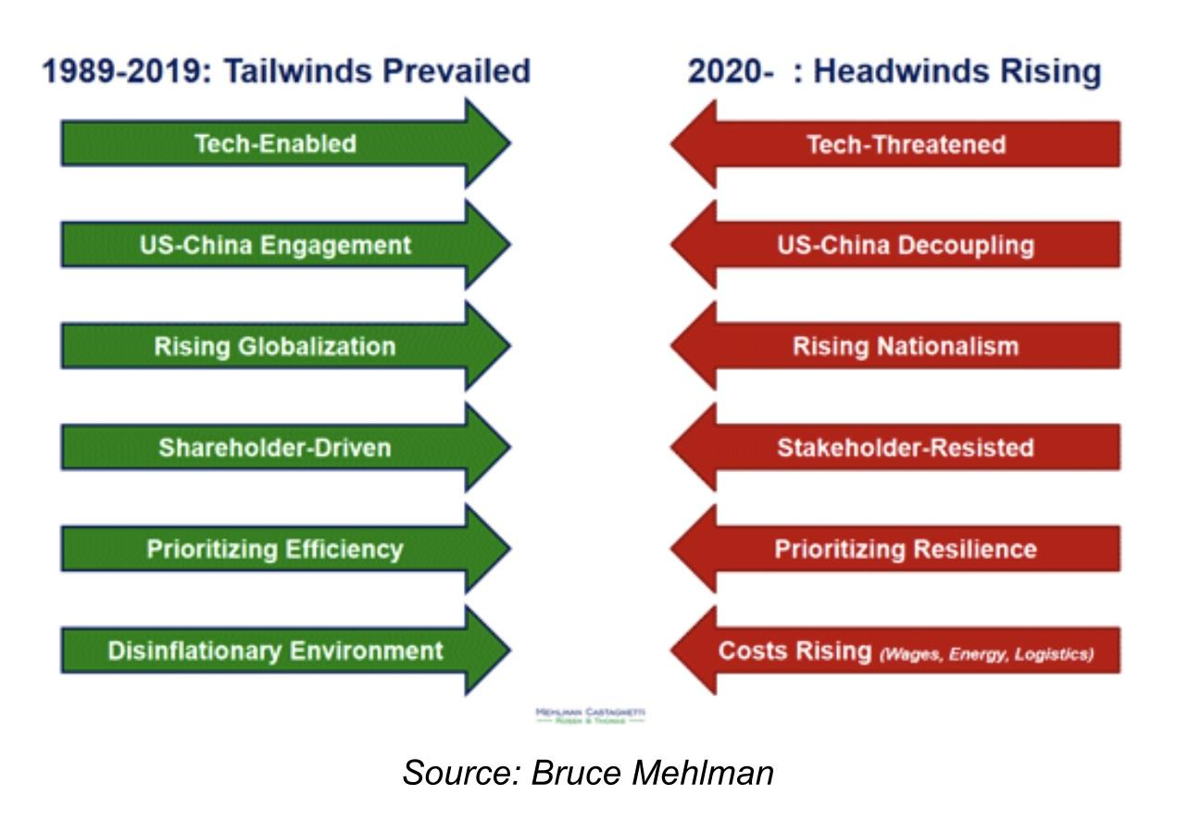
1Q 2022 Dade County Market Report
4Q 2018 Broward County Market Report
1Q 2022 Market Report
Proprietary Information
Greater Economy
Proprietary Information
CPI 8.5%

Slide 62
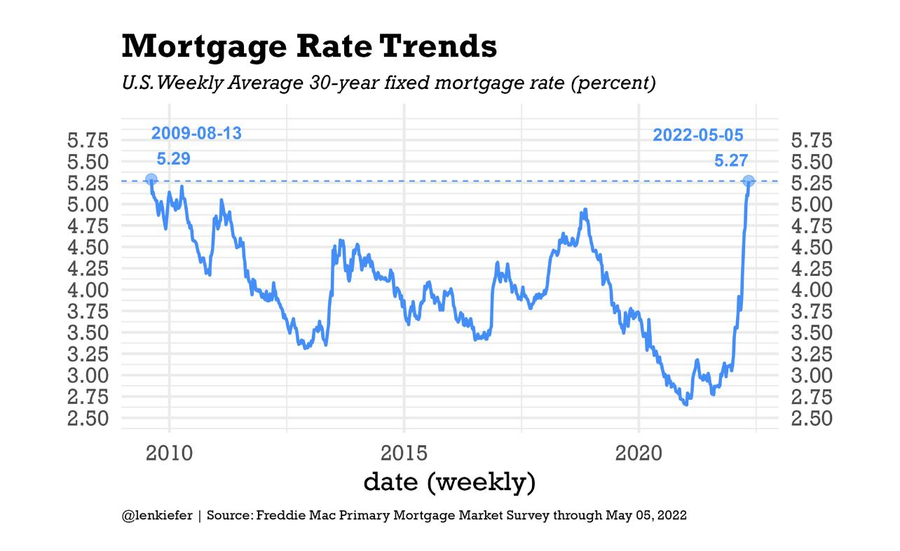
1Q 2022 Dade County Market Report
4Q 2018 Broward County Market Report
1Q 2022 Market Report
Proprietary Information
Proprietary Information

Slide 63
1Q 2022 Market Report
Proprietary Information
Mortgage Rate Comparison
Proprietary Information
Proprietary Information
Example: 500k w/ 20% down P&I Only
500k @ 3.5 = 1796 2/22
500k@ 4.25= 1967 (=+171) 3/24/22
500k @ 4.5= 2026 (=+ 230) 3/28/22
500k @ 5.0=2147 (=+351) 4/14/22
500k @ 5.5= 2271 (= +475) 5/4/22
500k @ 6.0 = 2398 (= +602) 5/9/22
500k @ 6.5 = 2528 (= +732)
500k @ 8.5= 3085.00 ( =+1289)
Broward County Single Family Detached Residences/ Condo/Townhouse Residences
Provided By Chart Master Services, LLC exclusively for Keller Williams Realty
Dade-Broward County Single Family Detached Residences/ Condo/Townhouse Residences
Provided By Chart Master Services, LLC exclusively for Keller Williams Realty

Slide 64
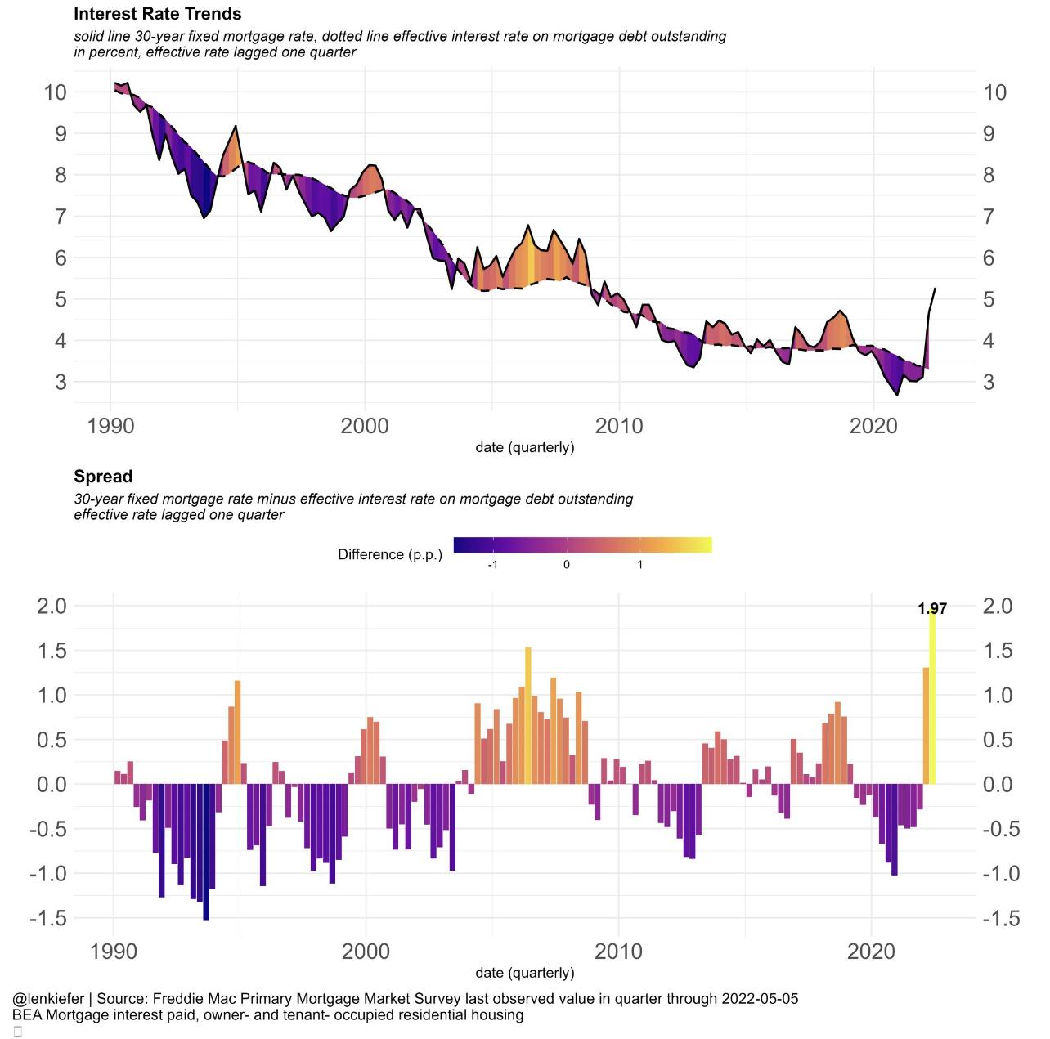
1Q 2022 Dade County Market Report
4Q 2018 Broward County Market Report
1Q 2022 Market Report
Proprietary Information
Proprietary Information

Slide 65
1Q 2022 Dade County Market Report
4Q 2018 Broward County Market Report
1Q 2022 Miami-Dade County Market Report
Proprietary Information
Dade Snapshot
Proprietary Information
Number Sold Single Family 3,420 Condo 6,070
Change in # Sold Y/Y Single Family -10.9% Condo 16.1%
Median Sales $ Single Family $530,000 Condo $380,000
Change in Price Y/Y Single Family 14.0% Condo 27.9%
% of original Sales $ received Single Family 98.2% Condo 97.1%
DOM Single Family 57 Condo 82
Change DOM Y/Y Single Family -16.2% Condo -32.2%
Incidence of Price Reduction Single Family 23.6% Condo 23.1%
Distressed Sales Single Family 1.3% Condo 0.8%
Failed Listing % Single Family 29.6% Condo 31.8%
% of Sales previously listed Single Family 36.3% Condo 49.0%
Months of Supply Single Family 1.7% Condo 2.2%

Slide 66
1Q 2022 Broward County Market Report
1Q 2022 Broward County Market Report
Proprietary Information
Broward Snapshot
Proprietary Information
Number Sold Single Family 3,879 Condo 5,184
Change in # Sold Y/Y Single Family -15.8% Condo -2.6%
Median Sales $ Single Family $520,000 Condo $240,000
Change in Price Y/Y Single Family 20.9% Condo 15.9%
% of original Sales $ received Single Family 100.0% Condo 98.1%
DOM Single Family 31 Condo 41
Change DOM Y/Y Single Family -45.6% Condo -49.4%
Incidence of Price Reduction Single Family 18.3% Condo 18.3%
Distressed Sales Single Family 0.9% Condo 0.8%
Failed Listing % Single Family 20.9% Condo 20.6%
% of Sales previously listed Single Family 22.7% Condo 28.9%
Months of Supply Single Family 1.1% Condo 1.3%

