Slide 1
1st Quarter 2023
Broward-Dade County
Metro Market Report
Single Family Detached Residences/
Condo/Townhome Residences

Slide 2
1Q Quarter 2023
Broward-Dade County
Metro Market Report Single Family Detached Residences/
Condo/Townhome Residences
ABOUT THIS REPORT
Terms of Use
These reports are created exclusively for Keller Williams Real Estate offices and provide a competitive advantage for agents in participating Keller Williams offices and should therefore be used in a manner to protect that advantage.
Reports are provided by ChartMaster Services, LLC exclusively to Keller Williams and should be treated as proprietary to those offices contracting for the service, not for distribution or posting to web sites in their entirety.
Reports, either whole or in part, may be used in consultations with clients and prospects during the normal conduct of business by real estate agents in offices contracting for the service.
Agents in contracting offices are also encouraged to use selected charts in lead-generation activities as a way to encourage prospective clients to contact the agent for additional information.
Acceptance and use of this report shall constitute acceptance of these terms.
MACRO VIEW: National Market
National Media Coverage
METRO VIEW: Broward & Dade County Market Quarterly Metro Market Report
MICRO VIEW: Your Neighborhood
Comparative Market Analysis
1st Quarter 2023 Metro Market Report Single Family Detached Residences / Condo/Townhouse/Villa Provided by ChartMaster Services, LLC
1Q 2023 Metro Market Report Single Family Detached Residences/Condo/Townhome Residences
Provided By ChartMaster Services, LLC
2

Slide 3
Notes:
PURPOSE/USE: Use to position a particular property by price range for more relevant comparison to same period last year. Also illustrates the differences by price range, particularly as price ranges become higher.

Slide 4
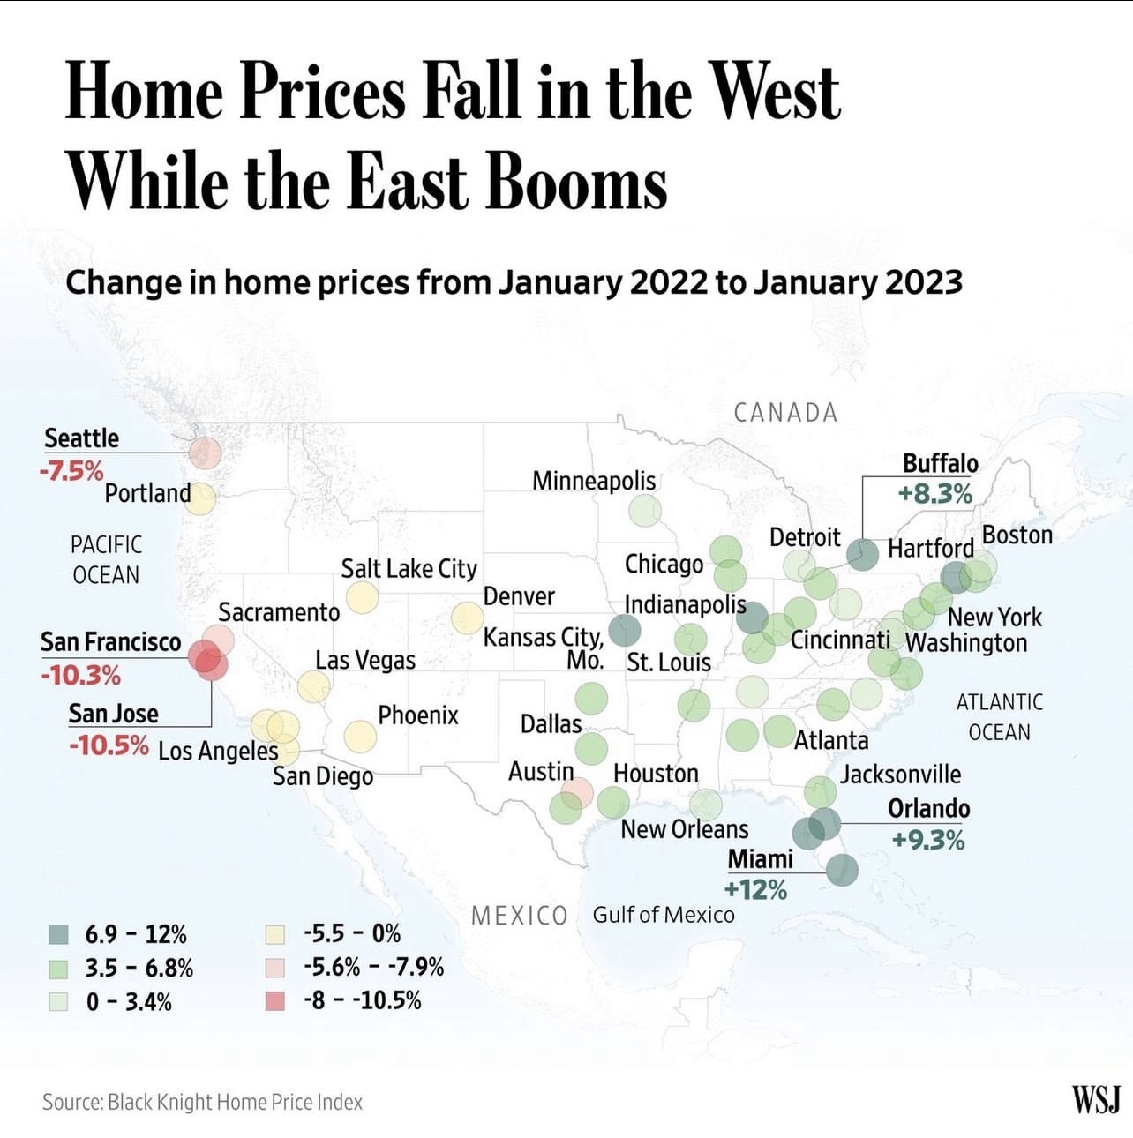
Notes:
PURPOSE/USE: Use to position a particular property by price range for more relevant comparison to same period last year. Also illustrates the differences by price range, particularly as price ranges become higher.

Slide 5
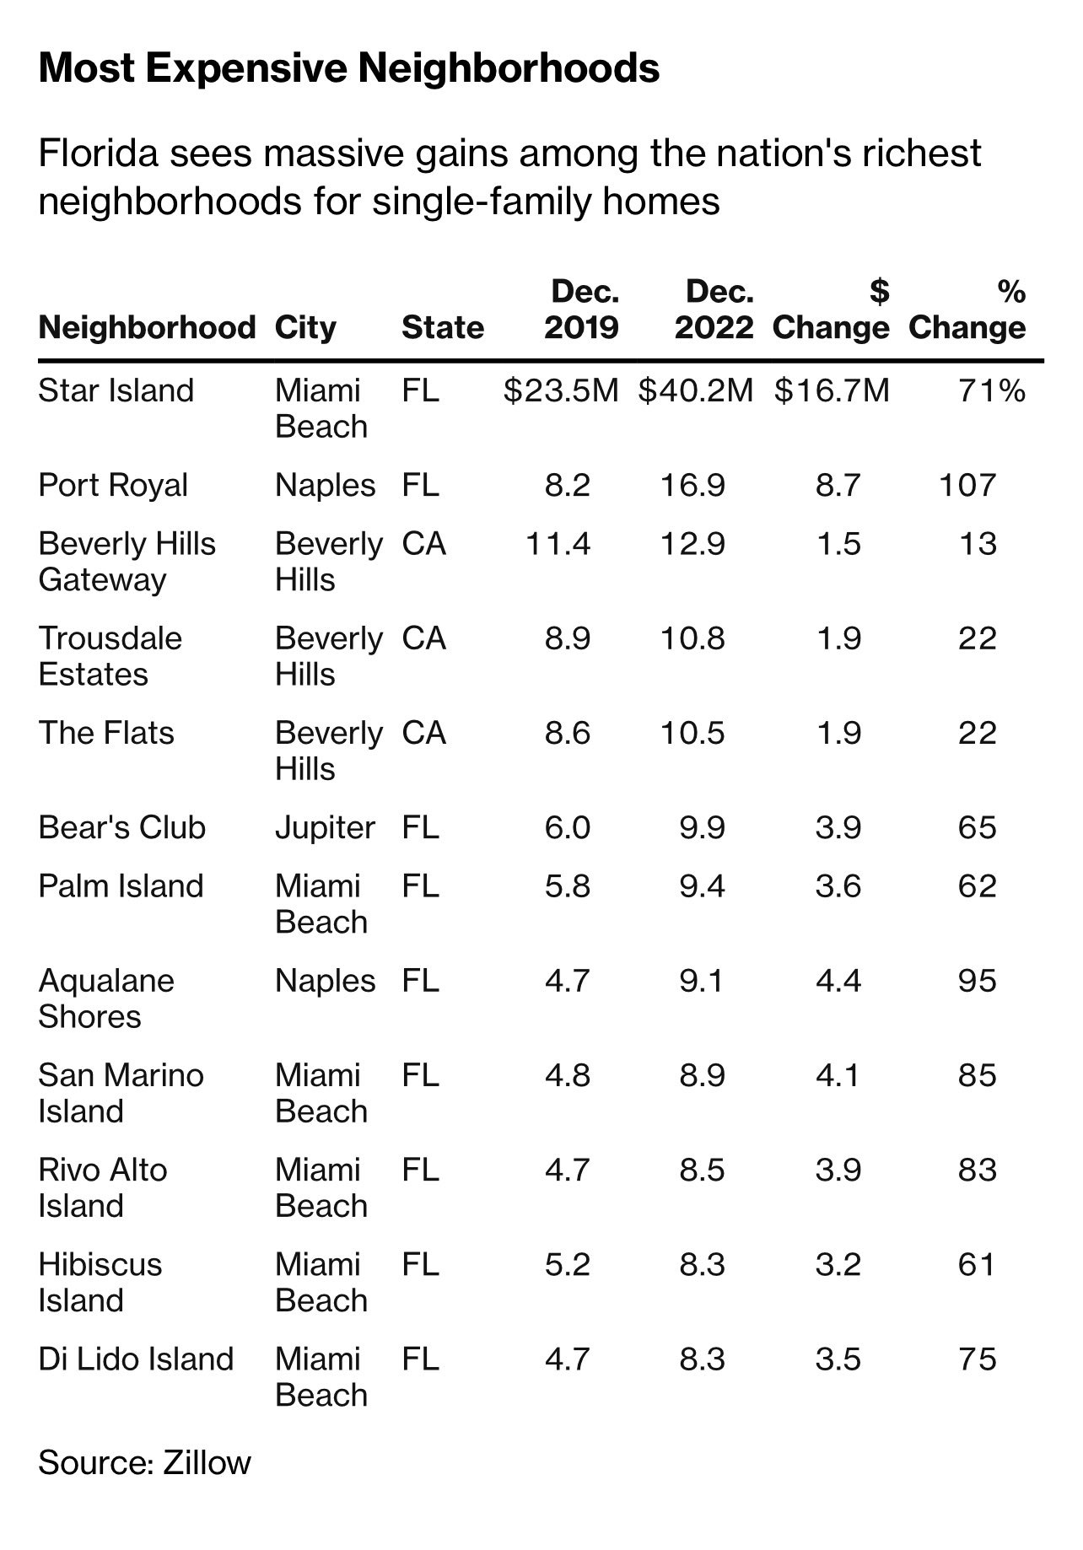

Slide 6
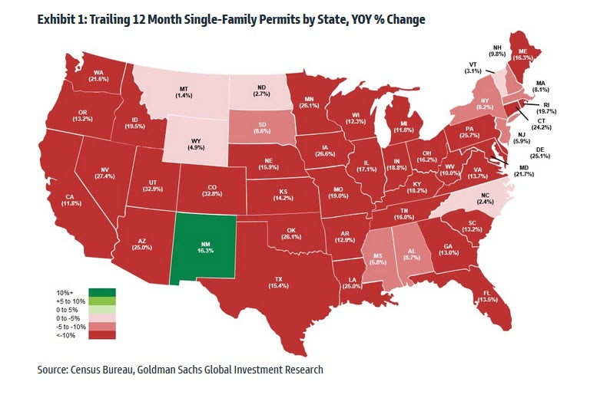

Slide 7
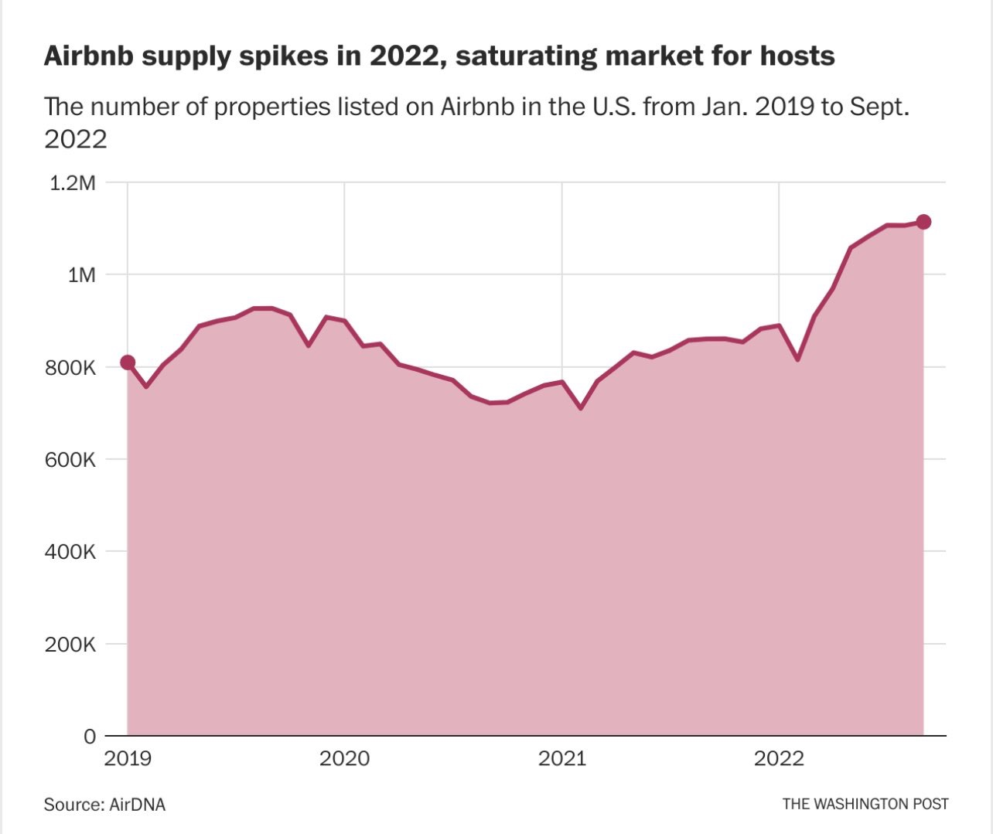

Slide 8
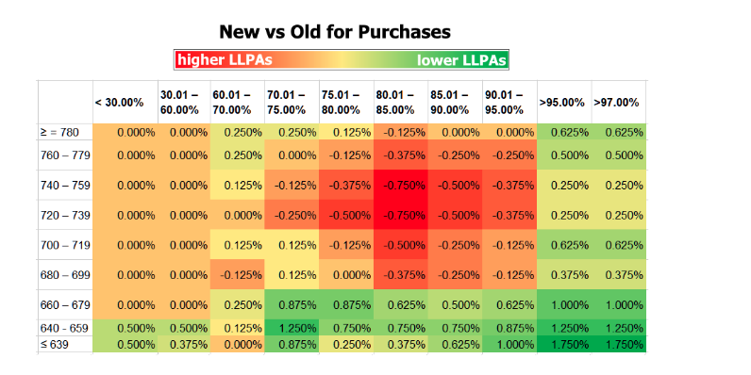
The FHFA. Here's their statement: https://www.fhfa.gov//Media/PublicAffairs/Pages/FHFA-Announces-Updates-to-Enterprises-SF-Pricing-Framework.aspx

Slide 12
1Q Quarter 2023
Broward-Dade County
Metro Market Report Single Family Detached Residences/
Condo/Townhome Residences
Table of Contents
If viewing PDF, click the underlined link to be directed to the desired slide(s). The last slide in each group will have a button at the bottom right which will direct you back to the Table of Contents.
In PowerPoint, hover over the underlined link and hit Ctrl + Click to be directed to the desired slide(s). The last slide in each group will have a button at the bottom right which will direct you back to the Table of Contents.
Market Share:
Shows the market share and trends for the top companies in the area and how Keller Williams Realty compares.
Key Market Statistics:
Shows the Quick Stats, the American Idol Chart and all the key charts / statistics broken down by price range for all selected counties combined.
First 30 Days:
Shows key statistics of closed sales that sold in the first 30 days as well as three key charts to validate Time vs. Results.
Financing Method:
Shows the types of financing utilized in purchases as well as Cash Purchase Trends.
Summary:
Quick bulleted summary of all the key statistics.
Interactive Charts:
Three interactive charts designed to help drill down in seller conversations to a refined area and price range. Also, the consequences of overpricing.
Trends:
Shows trends over multiple years and quarters.
Supply Driven Market :
These 5 charts are also on page 14 in one illustration. They are expanded and show how Price, S/OLP%, DOM and Price Reductions are all driven by Supply.
Quarterly Comparisons:
Shows the annual quarterly comparisons for the key statistics.
1st Quarter 2023 Metro Market Report Single Family Detached Residences / Condo/Townhouse/Villa Provided by ChartMaster Services, LLC
1Q 2023 Metro Market Report Single Family Detached Residences/Condo/Townhome Residences
Provided By ChartMaster Services, LLC
12

Slide 13
1st Quarter 2023
Broward County
Quarterly Market Report Single Family Detached Residences
KW is
NUMBER 1 in unit sales
1st Quarter 2023 Metro Market Report Single Family Detached Residences Provided by ChartMaster Services, LLC
Back to Table of Contents
13
Notes:
PURPOSE/USE: This chart can be used to bolster client impression that they are doing business with the best.

Slide 14
1st Quarter 2023
Dade County
Quarterly Market Report Single Family Detached Residences
KW is
NUMBER 1 in unit sales
1st Quarter 2023 Metro Market Report Single Family Detached Residences Provided by ChartMaster Services, LLC
1st Quarter 2023 Metro Market Report Single Family Detached Residences Provided by ChartMaster Services, LLC
Back to Table of Contents
14
Notes:
PURPOSE/USE: This chart can be used to bolster client impression that they are doing business with the best.

Slide 15
1st Quarter 2023
Broward County
Quarterly Market Report Condo/Townhome Residences
KW is battling for
NUMBER 1 in unit sales
1st Quarter 2023 Metro Market Report Condo/Townhouse/Villa Provided by ChartMaster Services, LLC
Back to Table of Contents
15
Notes:
PURPOSE/USE: This chart can be used to bolster client impression that they are doing business with one of the best.

Slide 16
1st Quarter 2023
Dade County
Quarterly Market Report Condo/Townhome Residences
KW is closing in on
NUMBER 1 in unit sales
1st Quarter 2023 Metro Market Report Condo/Townhouse/Villa Provided by ChartMaster Services, LLC
Back to Table of Contents
16
Notes:
PURPOSE/USE: This chart can be used to bolster client impression that they are doing business with one of the best.

Slide 17
1st Quarter 2023
Broward County
Quarterly Market Report Single Family Detached Residences
Quick Stats
YTD Sales Down by -32.3% vs. Last Year
Median Sales Price Up by +6.9% vs. Last Year
Median S/L = 94.5%, Down -5.5 Points vs. Last Year
Median DOM at 62, Up +121.4% vs. Last Year
1st Quarter 2023 Metro Market Report Single Family Detached Residences Provided by ChartMaster Services, LLC
17

Slide 18
1st Quarter 2023
Dade County
Quarterly Market Report Single Family Detached Residences
Quick Stats
YTD Sales Down -33.0% vs. Last Year
Median Sales Price Up +5.7% vs. Last Year
Median S/L = 94.3%, Down -3.9 Points vs. Last Year
Median DOM at 78, Up +44.4% vs. Last Year
1st Quarter 2023 Metro Market Report Single Family Detached Residences Provided by ChartMaster Services, LLC
18

Slide 19
1st Quarter 2023
Broward County
Quarterly Market Report Condo/Townhome Residences
Quick Stats
YTD Sales Down by -37.3% vs. Last Year
Median Sales Price Up by +13.4% vs. Last Year
Median S/L = 95.9%, Down -2.3 Points vs. Last Year
Median DOM at 46, Up +24.3% vs. Last Year
1st Quarter 2023 Metro Market Report Condo/Townhouse/Villa Provided by ChartMaster Services, LLC
19

Slide 20
1st Quarter 2023
Dade County
Quarterly Market Report Condo/Townhome Residences
Quick Stats
YTD Sales Down -50.5% vs. Last Year
Median Sales Price Up +5.3% vs. Last Year
Median S/L = 95.1%, Down -2.3 Points vs. Last Year
Median DOM at 73, Up +4.3% vs. Last Year
1st Quarter 2023 Metro Market Report Condo/Townhouse/Villa Provided by ChartMaster Services, LLC
20

Slide 21
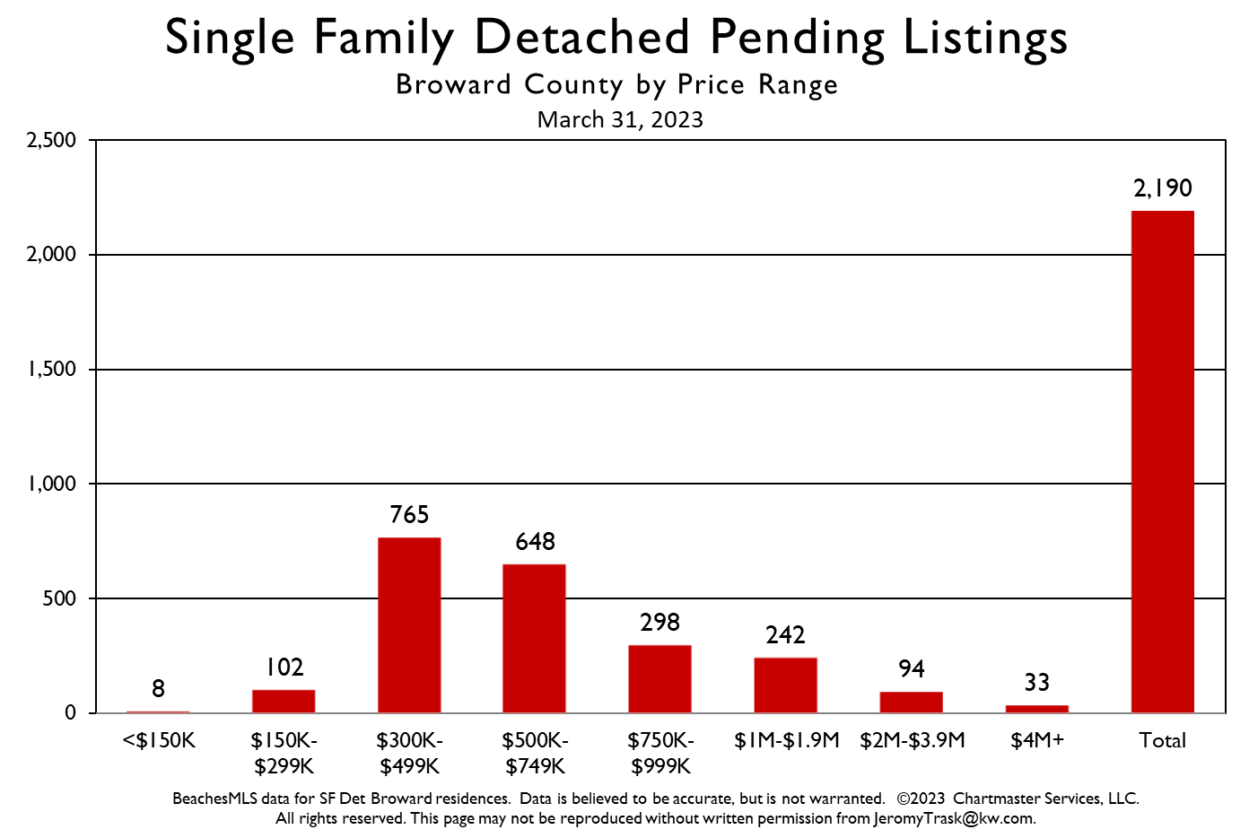
1st Quarter 2023
Broward County
Quarterly Market Report Single Family Detached Residences
19.9% of all Active Listings in March 2023 are priced lower than $500k.
38.2% of all Active Listings are priced higher than $1M.
1st Quarter 2023 Metro Market Report Single Family Detached Residences Provided by ChartMaster Services, LLC
1st Quarter 2023 Metro Market Report Single Family Detached Residences Provided by ChartMaster Services, LLC
21
Notes:
PURPOSE/USE: Use to position a particular property by price range for more relevant comparison to same period last year. Also illustrates the differences by price range, particularly as price ranges become higher.

Slide 22
1st Quarter 2023
Broward County
Quarterly Market Report Single Family Detached Residences
Under $500k
40.2% of Overall Sales
Down -40.3% vs. 1Q 2022
Over $500k
59.8% of Overall Sales
Down -25.6% vs. 1Q 2022
1st Quarter 2023 Metro Market Report Single Family Detached Residences Provided by ChartMaster Services, LLC
22
Notes:
PURPOSE/USE: Use to position a particular property by price range for more relevant comparison to same period last year. Also illustrates the differences by price range, particularly as price ranges become higher.

Slide 23
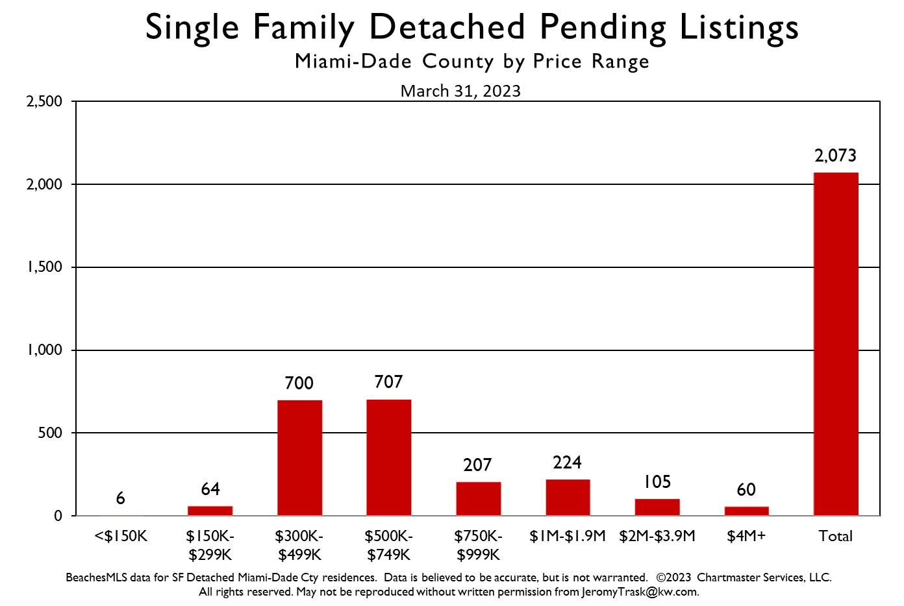
1st Quarter 2023
Dade County
Quarterly Market Report Single Family Detached Residences
12.0% of all Active Listings are priced lower than $500k.
49.6% of all Active Listings are priced higher than $1M.
1st Quarter 2023 Metro Market Report Single Family Detached Residences Provided by ChartMaster Services, LLC
23
Notes:
PURPOSE/USE: Use to position a particular property by price range for more relevant comparison to same period last year. Also illustrates the differences by price range, particularly as price ranges become higher.

Slide 24
1st Quarter 2023
Dade County
Quarterly Market Report Single Family Detached Residences
Under $500k
36.3% of Overall Sales
Down -44.3% vs. 1Q 2022
Over $500k
63.7% of Overall Sales
Down -24.3% vs. 1Q 2022
1st Quarter 2023 Metro Market Report Single Family Detached Residences Provided by ChartMaster Services, LLC
24
Notes:
PURPOSE/USE: Use to position a particular property by price range for more relevant comparison to same period last year. Also illustrates the differences by price range, particularly as price ranges become higher.

Slide 25
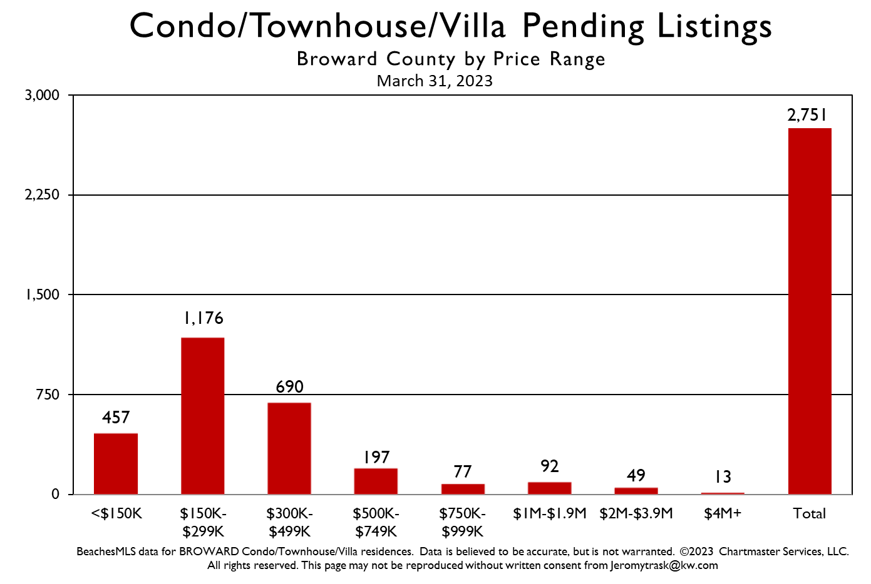
1st Quarter 2023
Broward County
Quarterly Market Report Condo/Townhome Residences
47.9% of all Active Listings in March 2023 are priced lower than $300k.
9.5% of all Active Listings are priced higher than $1M.
1st Quarter 2023 Metro Market Report Condo/Townhouse/Villa Provided by ChartMaster Services, LLC
25
Notes:
PURPOSE/USE: Use to position a particular property by price range for more relevant comparison to same period last year. Also illustrates the differences by price range, particularly as price ranges become higher.

Slide 26
1st Quarter 2023
Broward County
Quarterly Market Report Condo/Townhome Residences
Under $300k
56.7% of Overall Sales
Down -44.1% vs. 1Q 2022
Over $300k
43.3% of Overall Sales
Down -25.4% vs. 1Q 2022
1st Quarter 2023 Metro Market Report Condo/Townhouse/Villa Provided by ChartMaster Services, LLC
26
Notes:
PURPOSE/USE: Use to position a particular property by price range for more relevant comparison to same period last year. Also illustrates the differences by price range, particularly as price ranges become higher.

Slide 27
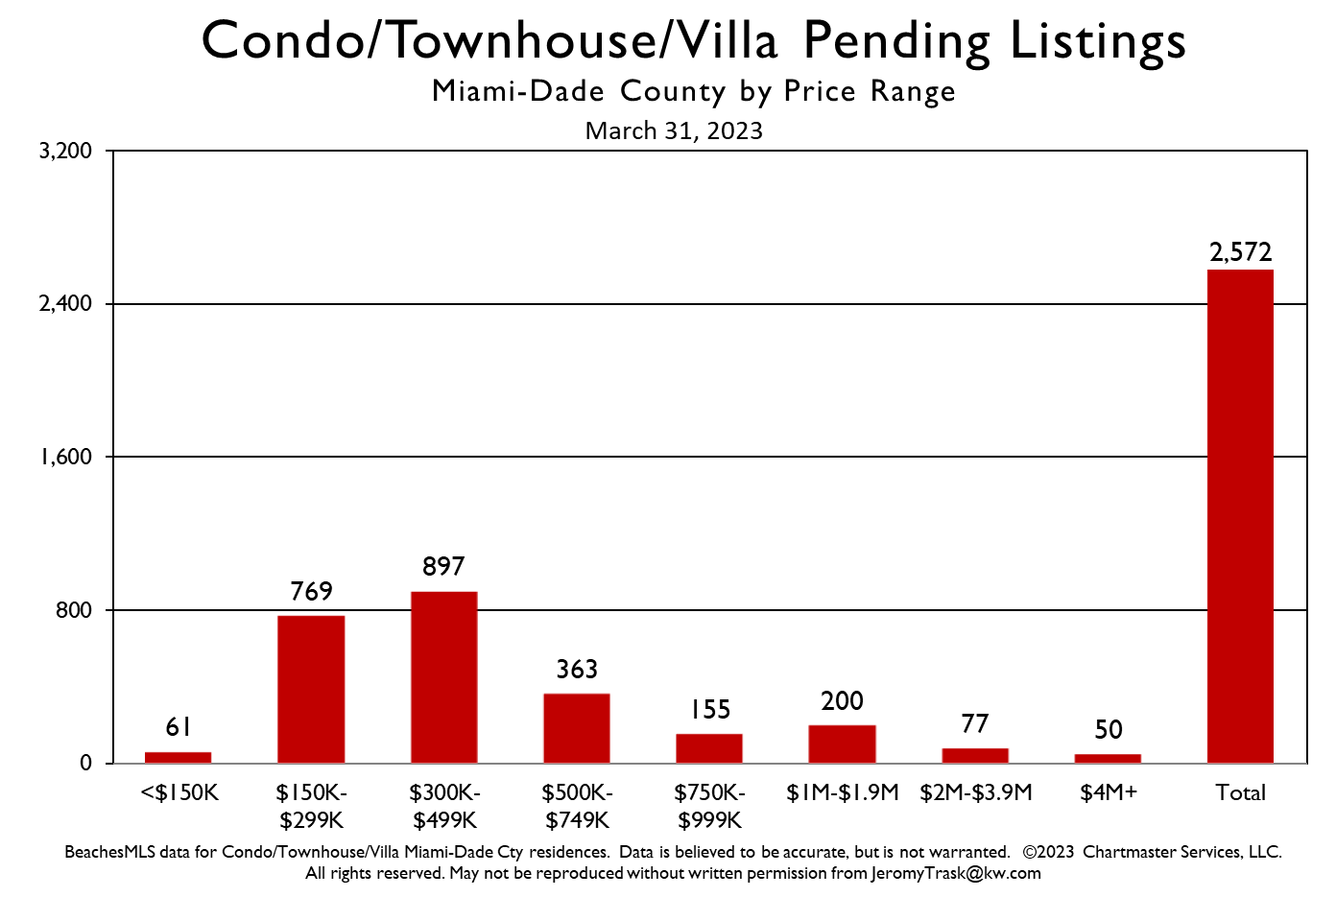
1st Quarter 2023
Dade County
Quarterly Market Report Condo/Townhome Residences
13.9% of all Active Listings are priced lower than $300k.
31.1% of all Active Listings are priced higher than $1M.
1st Quarter 2023 Metro Market Report Condo/Townhouse/Villa Provided by ChartMaster Services, LLC
27
Notes:
PURPOSE/USE: Use to position a particular property by price range for more relevant comparison to same period last year. Also illustrates the differences by price range, particularly as price ranges become higher.

Slide 28
1st Quarter 2023
Dade County
Quarterly Market Report Condo/Townhome Residences
Under $300k
29.7% of Overall Sales
Down -56.2% vs. 1Q 2022
Over $300k
70.3% of Overall Sales
Down -47.7% vs. 1Q 2022
1st Quarter 2023 Metro Market Report Condo/Townhouse/Villa Provided by ChartMaster Services, LLC
28
Notes:
PURPOSE/USE: Use to position a particular property by price range for more relevant comparison to same period last year. Also illustrates the differences by price range, particularly as price ranges become higher.

Slide 29
1st Quarter 2023
Broward County
Quarterly Market Report Single Family Detached Residences
40.0% of all Pending Sales in March 2023 are priced lower than $500k.
16.8% of all Pending Sales are priced higher than $1M.
1st Quarter 2023 Metro Market Report Single Family Detached Residences Provided by ChartMaster Services, LLC
29
Notes:
PURPOSE/USE: Use to position a particular property by price range for more relevant comparison to same period last year. Also illustrates the differences by price range, particularly as price ranges become higher.

Slide 30
1st Quarter 2023
Dade County
Quarterly Market Report Single Family Detached Residences
37.1% of all Pending Sales are priced lower than $500k.
18.8% of all Pending Sales are priced higher than $1M.
1st Quarter 2023 Metro Market Report Single Family Detached Residences Provided by ChartMaster Services, LLC
30
Notes:
PURPOSE/USE: Use to position a particular property by price range for more relevant comparison to same period last year. Also illustrates the differences by price range, particularly as price ranges become higher.

Slide 31
1st Quarter 2023
Broward County
Quarterly Market Report Condo/Townhome Residences
61.6% of all Pending Sales in March 2023 are priced lower than $300k.
11.2% of all Pending Sales are priced higher than $1M.
1st Quarter 2023 Metro Market Report Condo/Townhouse/Villa Provided by ChartMaster Services, LLC
31
Notes:
PURPOSE/USE: Use to position a particular property by price range for more relevant comparison to same period last year. Also illustrates the differences by price range, particularly as price ranges become higher.

Slide 32
1st Quarter 2023
Dade County
Quarterly Market Report Condo/Townhome Residences
32.3% of all Pending Sales are priced lower than $300k.
12.7% of all Pending Sales are priced higher than $1M.
1st Quarter 2023 Metro Market Report Condo/Townhouse/Villa Provided by ChartMaster Services, LLC
32
Notes:
PURPOSE/USE: Use to position a particular property by price range for more relevant comparison to same period last year. Also illustrates the differences by price range, particularly as price ranges become higher.

Slide 33
Overall 1Q 2023 Sales -32.3% lower vs. 1Q 2022
Fewer sales for homes below $500K were the largest factor in this change.
33
Notes:
PURPOSE/USE: This chart tracks quarterly changes in total sales compared to the same period in the prior by quarter.

Slide 34
1st Quarter 2023
Dade County
Quarterly Market Report Single Family Detached Residences
Overall 1Q 2023 Sales were -33.0% lower vs. 1Q 2022
Fewer sales for homes below $500K was the largest factor in this change.
1st Quarter 2023 Metro Market Report Single Family Detached Residences Provided by ChartMaster Services, LLC
34
Notes:
PURPOSE/USE: This chart tracks quarterly changes in total sales compared to the same period in the prior by quarter.

Slide 35
1st Quarter 2023
Broward County
Quarterly Market Report Condo/Townhome Residences
Overall 1Q 2023 Sales -37.3% lower vs. 1Q 2022
Fewer sales for homes below $300K were the largest factor in this change.
1st Quarter 2023 Metro Market Report Condo/Townhouse/Villa Provided by ChartMaster Services, LLC
35
Notes:
PURPOSE/USE: This chart tracks quarterly changes in total sales compared to the same period in the prior year by quarter.

Slide 36
1st Quarter 2023
Dade County
Quarterly Market Report Condo/Townhome Residences
Overall 1Q 2023 Sales were -50.5% lower vs. 1Q 2022
Fewer sales for homes below $300K was the largest factor in this change.
1st Quarter 2023 Metro Market Report Condo/Townhouse/Villa Provided by ChartMaster Services, LLC
36
Notes:
PURPOSE/USE: This chart tracks quarterly changes in total sales compared to the same period in the prior by quarter.

Slide 37
1st Quarter 2023
Broward County
Quarterly Market Report Single Family Detached Residences
1Q 2023 sales were -32.3% lower vs. 1Q 2022.
Decreases occurred in each month of the quarter.
1st Quarter 2023 Metro Market Report Single Family Detached Residences Provided by ChartMaster Services, LLC
37
Notes:
PURPOSE/USE: Use this chart to illustrate the quarterly trend in number of sales for the current period, showing each quarterly period for this year and the previous 2 years to identify changes that may indicate market direction. These numbers are for all price ranges in all the selected Cities.
Also, 1Q 2023 sales may increase a bit after lagged closings are processed into the MLS system.

Slide 38
1st Quarter 2023
Dade County
Quarterly Market Report Single Family Detached Residences
1Q 2023 sales (-33.0%) lower vs. 1Q 2022
Decrease occurred in each month of the quarter.
1st Quarter 2023 Metro Market Report Single Family Detached Residences Provided by ChartMaster Services, LLC
38
Notes:
PURPOSE/USE: Use this chart to illustrate the quarterly trend in number of sales for the current period, showing each quarterly period for this year and the previous 2 years to identify changes that may indicate market direction. These numbers are for all price ranges in all the selected Cities.
Also, 1Q 2023 sales may increase a bit after lagged closings are processed into the MLS system.

Slide 39
1st Quarter 2023
Broward County
Quarterly Market Report Condo/Townhome Residences
1Q 2023 sales were -37.3% lower vs. 1Q 2022.
Decreases occurred in each month of the quarter.
1st Quarter 2023 Metro Market Report Condo/Townhouse/Villa Provided by ChartMaster Services, LLC
39
Notes:
PURPOSE/USE: Use this chart to illustrate the quarterly trend in number of sales for the current period, showing each quarterly period for this year and the previous 2 years to identify changes that may indicate market direction. These numbers are for all price ranges in all the selected Cities.
Also, 1Q 2023 sales may increase a bit after lagged closings are processed into the MLS system.

Slide 40
1st Quarter 2023
Dade County
Quarterly Market Report Condo/Townhome Residences
1Q 2023 sales (-50.5%) lower vs. 1Q 2022
Decrease occurred in each month of the quarter.
1st Quarter 2023 Metro Market Report Condo/Townhouse/Villa Provided by ChartMaster Services, LLC
40
Notes:
PURPOSE/USE: Use this chart to illustrate the quarterly trend in number of sales for the current period, showing each quarterly period for this year and the previous 2 years to identify changes that may indicate market direction. These numbers are for all price ranges in all the selected Cities.
Also, 1Q 2023 sales may increase a bit after lagged closings are processed into the MLS system.

Slide 41
1st Quarter 2023
Broward County
Quarterly Market Report Single Family Detached Residences
1Q 2023 sales were lower in each month of the quarter vs. 2022 and 2021.
1st Quarter 2023 Metro Market Report Single Family Detached Residences Provided by ChartMaster Services, LLC
41
Notes:
PURPOSE/USE: Monthly sales are shown for the current year and 2 previous years in order to judge the trend in the current market.
After lagged closings are entered for last month, the gap could slightly decrease.

Slide 42
1st Quarter 2023
Dade County
Quarterly Market Report Single Family Detached Residences
1Q 2023 sales were lower in each month of the quarter vs. 2022 and 2021.
1st Quarter 2023 Metro Market Report Single Family Detached Residences Provided by ChartMaster Services, LLC
42
Notes:
PURPOSE/USE: Monthly sales are shown for the current year and 2 previous years in order to judge the trend in the current market.
After lagged closings are entered for last month, the gap could slightly decrease.

Slide 43
1st Quarter 2023
Broward County
Quarterly Market Report Condo/Townhome Residences
1Q 2023 sales lower in each month of the quarter vs. 1Q 2022 and 1Q 2021.
1st Quarter 2023 Metro Market Report Condo/Townhouse/Villa Provided by ChartMaster Services, LLC
43
Notes:
PURPOSE/USE: Monthly sales are shown for the current year and 2 previous years in order to judge the trend in the current market.
After lagged closings are entered for last month the gap could slightly decrease.

Slide 44
1st Quarter 2023
Dade County
Quarterly Market Report Condo/Townhome Residences
1Q 2023 sales were lower in each month of the quarter vs. 1Q 2022 & 1Q 2021.
1st Quarter 2023 Metro Market Report Condo/Townhouse/Villa Provided by ChartMaster Services, LLC
44
Notes:
PURPOSE/USE: Monthly sales are shown for the current year and 2 previous years in order to judge the trend in the current market. If monthly sales are on either an increasing or decreasing trajectory it will indicate future direction.
After lagged closings are entered for last month the gap could slightly decrease.

Slide 45
1st Quarter 2023
Broward County
Quarterly Market Report Single Family Detached Residences
“American Idol” Chart
1st Quarter 2023 Metro Market Report Single Family Detached Residences Provided by ChartMaster Services, LLC
45
Notes:
PURPOSE/USE: This chart is nicknamed the “American Idol” chart. Red bars (Active Listings) compare contestants who think they can sing while the short gray bars (Closed Listings) compare those who really can sing and “go to Hollywood”. Nicknames are often used for some charts to aid in references to the messages they contain.
Use this chart to show that going further back in the market cycle using each current-month’s active listings divided by the average of the previous 3 months of closings yields the monthly supply (black line).
The number of properties listed for sale compared to the number of properties which sold each quarter for Broward County, illustrates the degree of balance existing between supply (active listings) and demand (sales).

Slide 46
1st Quarter 2023
Dade County
Quarterly Market Report Single Family Detached Residences
“American Idol” Chart
1st Quarter 2023 Metro Market Report Single Family Detached Residences Provided by ChartMaster Services, LLC
46
Notes:
PURPOSE/USE: This chart is nicknamed the “American Idol” chart. Red bars (Active Listings) compare contestants who think they can sing while the short gray bars (Closed Listings) compare those who really can sing and “go to Hollywood”. Nicknames are often used for some charts to aid in references to the messages they contain.
Use this chart to show that going further back in the market cycle using each current-month’s active listings divided by the average of the previous 3 months of closings yields the monthly supply (black line).
The number of properties listed for sale compared to the number of properties which sold each quarter for Miami-Dade County, illustrates the degree of balance existing between supply (active listings) and demand (sales).

Slide 47
1st Quarter 2023
Broward County
Quarterly Market Report Condo/Townhome Residences
“American Idol” Chart
1st Quarter 2023 Metro Market Report Condo/Townhouse/Villa Provided by ChartMaster Services, LLC
47
Notes:
PURPOSE/USE: This chart is nicknamed the “American Idol” chart. Red bars (Active Listings) compare contestants who think they can sing while the short gray bars (Closed Listings) compare those who really can sing and “go to Hollywood”. Nicknames are often used for some charts to aid in references to the messages they contain.
Use this chart to show that going further back in the market cycle using each current-month’s active listings divided by the average of the previous 3 months of closings yields the monthly supply (black line).
The number of properties listed for sale compared to the number of properties which sold each quarter for Broward County, illustrates the degree of balance existing between supply (active listings) and demand (sales).

Slide 48
1st Quarter 2023
Dade County
Quarterly Market Report Condo/Townhome Residences
“American Idol” Chart
1st Quarter 2023 Metro Market Report Condo/Townhouse/Villa Provided by ChartMaster Services, LLC
48
Notes:
PURPOSE/USE: This chart is nicknamed the “American Idol” chart. Red bars (Active Listings) compare contestants who think they can sing while the short gray bars (Closed Listings) compare those who really can sing and “go to Hollywood”. Nicknames are often used for some charts to aid in references to the messages they contain.
Use this chart to show that going further back in the market cycle using each current-month’s active listings divided by the average of the previous 3 months of closings yields the monthly supply (black line).
The number of properties listed for sale compared to the number of properties which sold each quarter for Miami-Dade County, illustrates the degree of balance existing between supply (active listings) and demand (sales).

Slide 49
1st Quarter 2023
Broward County
Quarterly Market Report Single Family Detached Residences
1Q 2023: Median Sales Price increased +6.9%
This represents the lowest percentage increase since the height of the Pandemic.
1st Quarter 2023 Metro Market Report Single Family Detached Residences Provided by ChartMaster Services, LLC
49
Notes:
PURPOSE/USE: Use this chart to show the percentage increases in median sales price during recent periods. Illustrates recent trend by using percentage increases for each quarter vs. the same quarter of the previous year.

Slide 50
1st Quarter 2023
Dade County
Quarterly Market Report Single Family Detached Residences
1Q 2023: Median Sales Price increased +5.7%
This represents the lowest annual percentage growth since the height of the Pandemic.
1st Quarter 2023 Metro Market Report Single Family Detached Residences Provided by ChartMaster Services, LLC
50
Notes:
PURPOSE/USE: Use this chart to show the percentage increases in median sales price during recent periods. Illustrates recent trend by using percentage increases for each quarter vs. the same quarter of the previous year.

Slide 51
1st Quarter 2023
Broward County
Quarterly Market Report Condo/Townhome Residences
1Q 2023: Median Sales Price increased +13.4%
This represents the 10th out of the last 11 quarters with a double-digit increase.
1st Quarter 2023 Metro Market Report Condo/Townhouse/Villa Provided by ChartMaster Services, LLC
51
Notes:
PURPOSE/USE: Use this chart to show the percentage increases in median sales price during recent periods. Illustrates recent trend by using percentage increases for each quarter vs. the same quarter of the previous year.

Slide 52
1st Quarter 2023
Dade County
Quarterly Market Report Condo/Townhome Residences
1Q 2023: Median Sales Price increased +5.3%
This represents a return to near Pre-Pandemic percentage increase levels.
1st Quarter 2023 Metro Market Report Condo/Townhouse/Villa Provided by ChartMaster Services, LLC
52
Notes:
PURPOSE/USE: Use this chart to show the percentage increases in median sales price during recent periods. Illustrates recent trend by using percentage increases for each quarter vs. the same quarter of the previous year.

Slide 53
1st Quarter 2023
Broward County
Quarterly Market Report Single Family Detached Residences
Median price rose again in 1Q 2023 and remains above the long term trendline.
1st Quarter 2023 Metro Market Report Single Family Detached Residences Provided by ChartMaster Services, LLC
53
Notes:
PURPOSE/USE: This chart shows the trend in Median Sales Prices since 2014. Also demonstrates the seasonality of real estate sales in Broward County.

Slide 54
1st Quarter 2023
Dade County
Quarterly Market Report Single Family Detached Residences
Median price rose again in 1Q 2023 and is just below the all-time high set last year.
Remains above the long term trendline.
1st Quarter 2023 Metro Market Report Single Family Detached Residences Provided by ChartMaster Services, LLC
54
Notes:
PURPOSE/USE: This chart shows the trend in Median Sales Prices since 2014. Also demonstrates the seasonality of real estate sales in Miami-Dade County.

Slide 55
1st Quarter 2023
Broward County
Quarterly Market Report Condo/Townhome Residences
1Q 2023 Median Price rose to a new all-time high of $270,200 and remains considerably above the long term trendline.
1st Quarter 2023 Metro Market Report Condo/Townhouse/Villa Provided by ChartMaster Services, LLC
55
Notes:
PURPOSE/USE: This chart shows the trend in Median Sales Prices since 2014. Also demonstrates the seasonality of real estate sales in Broward County.

Slide 56
1st Quarter 2023
Dade County
Quarterly Market Report Condo/Townhome Residences
Rising trend accelerated the last two years and appears to be leveling out.
Still above the long term trendline.
1st Quarter 2023 Metro Market Report Condo/Townhouse/Villa Provided by ChartMaster Services, LLC
56
Notes:
PURPOSE/USE: This chart shows the trend in Median Sales Prices since 2014. Also demonstrates the seasonality of real estate sales in Miami-Dade County.

Slide 57
1st Quarter 2023
Broward County
Quarterly Market Report Single Family Detached Residences
A strong Seller’s Market developed during Q3 2020.
Supply dropped again in 1Q 2023 and remains in a Seller’s Market Condition.
1st Quarter 2023 Metro Market Report Single Family Detached Residences Provided by ChartMaster Services, LLC
57
Notes:
PURPOSE/USE: Tracking of Supply to show when the Seller’s Market developed as well as the current trend.
Increasing sales combined with a low inventory of Active listings maintain a “Seller‘s Market” condition. When sales decline and inventory increases, the shift will move back to a Balanced or Buyer’s Market.

Slide 58
1st Quarter 2023
Dade County
Quarterly Market Report Single Family Detached Residences
A Strong Seller’s Market Developed during Q2 2020.
Supply moved slightly lower again in 1Q 2023.
1st Quarter 2023 Metro Market Report Single Family Detached Residences Provided by ChartMaster Services, LLC
58
Notes:
PURPOSE/USE: Tracking of Supply to show when the Seller’s Market developed as well as the current trend.
Increasing sales combined with a low inventory of Active listings maintain a “Seller‘s Market” condition. When sales decline and inventory increases, the shift will move back to a Balanced or Buyer’s Market.

Slide 59
1st Quarter 2023
Broward County
Quarterly Market Report Condo/Townhome Residences
A strong Seller’s Market developed during Q3 2020.
Supply is rising but remains in a Seller’s Market Condition.
1st Quarter 2023 Metro Market Report Condo/Townhouse/Villa Provided by ChartMaster Services, LLC
59
Notes:
PURPOSE/USE: Tracking of Supply to show when the Seller’s Market developed as well as the current trend.
Increasing sales combined with a low inventory of Active listings maintain a “Seller‘s Market” condition. When sales decline and inventory increases, the shift will move back to a Balanced or Buyer’s Market.

Slide 60
1st Quarter 2023
Dade County
Quarterly Market Report Condo/Townhome Residences
A Seller’s Market Developed during Q1 2021.
Supply moved back to a Balanced Market Condition in 1Q 2023.
1st Quarter 2023 Metro Market Report Condo/Townhouse/Villa Provided by ChartMaster Services, LLC
60
Notes:
PURPOSE/USE: Tracking of Supply to show when the Seller’s Market developed as well as the current trend.
Increasing sales combined with a low inventory of Active listings maintain a “Seller‘s Market” condition. When sales decline and inventory increases, the shift will move back to a Balanced or Buyer’s Market.

Slide 61
1st Quarter 2023
Broward County
Quarterly Market Report Single Family Detached Residences
A Seller’s Market = Rising Median Sales Price
1st Quarter 2023 Metro Market Report Single Family Detached Residences Provided by ChartMaster Services, LLC
61
Notes:
PURPOSE/USE: One in the series of charts showing the changes which occurred once the supply fell below 6 months (Seller’s Market threshold). This chart illustrates that the median sales price rises when a seller’s market condition occurs.

Slide 62
1st Quarter 2023
Dade County
Quarterly Market Report Single Family Detached Residences
A Seller’s Market = Rising Median Sales Price
1st Quarter 2023 Metro Market Report Single Family Detached Residences Provided by ChartMaster Services, LLC
62
Notes:
PURPOSE/USE: One in the series of charts showing the changes which occurred once the supply fell below 6 months (Seller’s Market threshold). This chart illustrates that the median sales price rises when a seller’s market condition occurs.

Slide 63
1st Quarter 2023
Broward County
Quarterly Market Report Condo/Townhome Residences
A Seller’s Market = Rising Median Sales Price
1st Quarter 2023 Metro Market Report Condo/Townhouse/Villa Provided by ChartMaster Services, LLC
63
Notes:
PURPOSE/USE: One in the series of charts showing the changes which occurred once the supply fell below 6 months (Seller’s Market threshold). This chart illustrates that the median sales price rises when a seller’s market condition occurs.

Slide 64
1st Quarter 2023
Dade County
Quarterly Market Report Condo/Townhome Residences
A Balanced Market = Generally Flat Median Sales Price Growth
1st Quarter 2023 Metro Market Report Condo/Townhouse/Villa Provided by ChartMaster Services, LLC
64
Notes:
PURPOSE/USE: One in the series of charts showing the changes which occurred once the supply fell below 6 months (Seller’s Market threshold). This chart illustrates that the median sales price rises when a seller’s market condition occurs.

Slide 65
1st Quarter 2023
Broward County
Quarterly Market Report Single Family Detached Residences
As Supply rises, so do the Days on Market.
1st Quarter 2023 Metro Market Report Single Family Detached Residences Provided by ChartMaster Services, LLC
65
Notes:
PURPOSE/USE: Use to demonstrate that median DOM tends to move in the same direction as Months of Inventory. Note that days from previous listing periods for properties that were off-market for more than 30 days are also included here, providing a more realistic measurement.
As is seen in the charts of other measurements, the median DOM follows the trend for supply very closely demonstrating a strong relationship between the two.

Slide 66
1st Quarter 2023
Dade County
Quarterly Market Report Single Family Detached Residences
As Supply rises, so do the Days on Market.
1st Quarter 2023 Metro Market Report Single Family Detached Residences Provided by ChartMaster Services, LLC
66
Notes:
PURPOSE/USE: Use to demonstrate that median DOM tends to move in the same direction as Months of Inventory. Note that days from previous listing periods for properties that were off-market for more than 30 days are also included here, providing a more realistic measurement.
As is seen in the charts of other measurements, the median DOM follows the trend for supply very closely demonstrating a strong relationship between the two.

Slide 67
1st Quarter 2023
Broward County
Quarterly Market Report Condo/Townhome Residences
As Supply rises, so do the Days on Market.
1st Quarter 2023 Metro Market Report Condo/Townhouse/Villa Provided by ChartMaster Services, LLC
67
Notes:
PURPOSE/USE: Use to demonstrate that median DOM tends to move in the same direction as Months of Inventory. Note that days from previous listing periods for properties that were off-market for more than 30 days are also included here, providing a more realistic measurement.
As is seen in the charts of other measurements, the median DOM follows the trend for supply very closely demonstrating a strong relationship between the two.

Slide 68
1st Quarter 2023
Dade County
Quarterly Market Report Condo/Townhome Residences
As Supply rises, so do the Days on Market.
1st Quarter 2023 Metro Market Report Condo/Townhouse/Villa Provided by ChartMaster Services, LLC
68
Notes:
PURPOSE/USE: Use to demonstrate that median DOM tends to move in the same direction as Months of Inventory. Note that days from previous listing periods for properties that were off-market for more than 30 days are also included here, providing a more realistic measurement.
As is seen in the charts of other measurements, the median DOM follows the trend for supply very closely demonstrating a strong relationship between the two.

Slide 69
1st Quarter 2023
Broward County
Quarterly Market Report Single Family Detached Residences
1Q 2023 Median S/OLP of 94.5% is down -5.5 percentage points compared to 1Q 2022.
Decreases in ALL price ranges.
1st Quarter 2023 Metro Market Report Single Family Detached Residences Provided by ChartMaster Services, LLC
69
Notes:
PURPOSE/USE: Allows S/OLP % comparison by price range vs. previous year. Note that data from previous listing periods for properties that were off-market for more than 30 days are also included here, providing a more realistic measurement.

Slide 70
1st Quarter 2023
Dade County
Quarterly Market Report Single Family Detached Residences
1Q 2023 Median S/OLP of 94.3% is down -3.9 percentage points compared to 1Q 2022
Decreases in ALL price ranges.
1st Quarter 2023 Metro Market Report Single Family Detached Residences Provided by ChartMaster Services, LLC
70
Notes:
PURPOSE/USE: Allows S/OLP % comparison by price range vs. previous year. Note that data from previous listing periods for properties that were off-market for more than 30 days are also included here, providing a more realistic measurement.

Slide 71
1st Quarter 2023
Broward County
Quarterly Market Report Condo/Townhome Residences
1Q 2023 Median S/OLP of 95.9% is -2.3 percentage points lower than 1Q 2022.
Decreases in ALL price ranges.
1st Quarter 2023 Metro Market Report Condo/Townhouse/Villa Provided by ChartMaster Services, LLC
71
Notes:
PURPOSE/USE: Allows S/OLP % comparison by price range vs. previous year. Note that data from previous listing periods for properties that were off-market for more than 30 days are also included here, providing a more realistic measurement.

Slide 72
1st Quarter 2023
Dade County
Quarterly Market Report Condo/Townhome Residences
1Q 2023 Median S/OLP of 95.1% is down -2.3 percentage points compared to 1Q 2022
Decreases in ALL price ranges.
1st Quarter 2023 Metro Market Report Condo/Townhouse/Villa Provided by ChartMaster Services, LLC
72
Notes:
PURPOSE/USE: Allows S/OLP % comparison by price range vs. previous year. Note that data from previous listing periods for properties that were off-market for more than 30 days are also included here, providing a more realistic measurement.

Slide 73
1st Quarter 2023
Broward County
Quarterly Market Report Single Family Detached Residences
21.1% of all sales in 1Q 2023, a decrease of -33.2 percentage points over 1Q 2022, sold at 100% or more of original listing price.
Decreases in ALL price ranges.
1st Quarter 2023 Metro Market Report Single Family Detached Residences Provided by ChartMaster Services, LLC
73
Notes:
PURPOSE/USE: The high percentage of closed transactions selling for more than the list price is further evidence that sellers pricing correctly for the market have a competitive advantage during negotiations.

Slide 74
1st Quarter 2023
Dade County
Quarterly Market Report Single Family Detached Residences
21.4% of all sales in 1Q 2023, a decrease of -21.1 percentage points vs. 1Q 2022, sold at or above original listing price.
Lower in ALL price ranges.
1st Quarter 2023 Metro Market Report Single Family Detached Residences Provided by ChartMaster Services, LLC
74
Notes:
PURPOSE/USE: The high percentage of closed transactions selling for more than the list price is further evidence that sellers pricing correctly for the market have a competitive advantage during negotiations.

Slide 75
1st Quarter 2023
Broward County
Quarterly Market Report Condo/Townhome Residences
25.2% of all sales in 1Q 2023 (down -17.8 percentage points over 1Q 2022) sold at 100% or more of the original list price.
Lower in 6 of 8 price ranges.
1st Quarter 2023 Metro Market Report Condo/Townhouse/Villa Provided by ChartMaster Services, LLC
75
Notes:
PURPOSE/USE: The high percentage of closed transactions selling for more than the list price is further evidence that sellers pricing correctly for the market have a competitive advantage during negotiations.

Slide 76
1st Quarter 2023
Dade County
Quarterly Market Report Condo/Townhome Residences
21.0% of all sales in 1Q 2023, down -13.3 percentage points over 1Q 2022, sold at 100% or more of original listing price.
Decreases in ALL price ranges.
1st Quarter 2023 Metro Market Report Condo/Townhouse/Villa Provided by ChartMaster Services, LLC
76
Notes:
PURPOSE/USE: The high percentage of closed transactions selling for more than the list price is further evidence that sellers pricing correctly for the market have a competitive advantage during negotiations.

Slide 77
1st Quarter 2023
Broward County
Quarterly Market Report Single Family Detached Residences
Overall, up by +121.4% (+34 days) in 1Q 2023 vs 1Q 2022 to 62 days.
Increases in 7 of 8 price ranges.
1st Quarter 2023 Metro Market Report Single Family Detached Residences Provided by ChartMaster Services, LLC
77
Notes:
PURPOSE/USE: Use to position a particular property by price range for more relevant comparison to same period last year. Also illustrates the differences by price range, particularly as price ranges become higher. Note that days from previous listing periods for properties that were off-market for more than 30 days are also included here, providing a more realistic measurement.

Slide 78
1st Quarter 2023
Dade County
Quarterly Market Report Single Family Detached Residences
Overall, up by +44.4% in 1Q 2023 vs 1Q 2022 to 78 days.
Higher than 1Q 2022 in 7 of 8 price ranges.
1st Quarter 2023 Metro Market Report Single Family Detached Residences Provided by ChartMaster Services, LLC
78
Notes:
PURPOSE/USE: Use to position a particular property by price range for more relevant comparison to same period last year. Also illustrates the differences by price range, particularly as price ranges become higher. Note that days from previous listing periods for properties that were off-market for more than 30 days are also included here, providing a more realistic measurement.

Slide 79
1st Quarter 2023
Broward County
Quarterly Market Report Condo/Townhome Residences
46 days Overall, up by 9 days (+24.3%) vs. 1Q 2022.
However, DOM were lower vs. 1Q 2022 in homes priced above $2M.
1st Quarter 2023 Metro Market Report Condo/Townhouse/Villa Provided by ChartMaster Services, LLC
79
Notes:
PURPOSE/USE: Use to position a particular property by price range for more relevant comparison to same period last year. Also illustrates the differences by price range, particularly as price ranges become higher. Note that days from previous listing periods for properties that were off-market for more than 30 days are also included here, providing a more realistic measurement.

Slide 80
1st Quarter 2023
Dade County
Quarterly Market Report Condo/Townhome Residences
Overall, up by +4.3% (+3 days) in 1Q 2023 vs. 1Q 2022 to 73 days.
Increases in 6 of 8 price ranges.
1st Quarter 2023 Metro Market Report Condo/Townhouse/Villa Provided by ChartMaster Services, LLC
80
Notes:
PURPOSE/USE: Use to position a particular property by price range for more relevant comparison to same period last year. Also illustrates the differences by price range, particularly as price ranges become higher. Note that days from previous listing periods for properties that were off-market for more than 30 days are also included here, providing a more realistic measurement.

Slide 81
1st Quarter 2023
Broward County
Quarterly Market Report Single Family Detached Residences
RISK ASSESSMENT: Price Reductions
1Q 2023 was higher than 1Q 2022 by +32.4 Points overall to 50.5% of all closings having been reduced.
Increases in ALL price ranges above $150k.
1st Quarter 2023 Metro Market Report Single Family Detached Residences Provided by ChartMaster Services, LLC
81
Notes:
PURPOSE/USE: Similar to the previous chart, this chart is used to show the incidence of price reductions which occurred in the most recent period in Broward County, both in total (2 far right bars) and in various price ranges. It also shows any changes that may be occurring in the incidence of price reductions compared to the same period last year and allows focus on a particular price range.

Slide 82
1st Quarter 2023
Dade County
Quarterly Market Report Single Family Detached Residences
RISK ASSESSMENT: Price Reductions
Overall, higher vs. last year at 47.6% of all closings. (+24.3 percentage points.)
Increases in ALL price ranges.
1st Quarter 2023 Metro Market Report Single Family Detached Residences Provided by ChartMaster Services, LLC
82
Notes:
PURPOSE/USE: Similar to the previous chart, this chart is used to show the incidence of price reductions which occurred in the most recent period in Miami-Dade County, both in total (2 far right bars) and in various price ranges. It also shows any changes that may be occurring in the incidence of price reductions compared to the same period last year and allows focus on a particular price range.

Slide 83
1st Quarter 2023
Broward County
Quarterly Market Report Condo/Townhome Residences
RISK ASSESSMENT: Price Reductions
32.5% of all 1Q 2023 closings having been reduced, higher by +14.9 points overall vs. 1Q 2022.
Increases in ALL price ranges.
1st Quarter 2023 Metro Market Report Condo/Townhouse/Villa Provided by ChartMaster Services, LLC
83
Notes:
PURPOSE/USE: Similar to the previous chart, this chart is used to show the incidence of price reductions which occurred in the most recent period in Broward County, both in total (2 far right bars) and in various price ranges. It also shows any changes that may be occurring in the incidence of price reductions compared to the same period last year and allows focus on a particular price range.

Slide 84
1st Quarter 2023
Dade County
Quarterly Market Report Condo/Townhome Residences
RISK ASSESSMENT: Price Reductions
Overall, up +15.1 percentage points to 34.8% of all closings vs. 1Q 2022.
Increases in ALL price ranges.
1st Quarter 2023 Metro Market Report Condo/Townhouse/Villa Provided by ChartMaster Services, LLC
84
Notes:
PURPOSE/USE: Similar to the previous chart, this chart is used to show the incidence of price reductions which occurred in the most recent period in Miami-Dade County, both in total (2 far right bars) and in various price ranges. It also shows any changes that may be occurring in the incidence of price reductions compared to the same period last year and allows focus on a particular price range.

Slide 85
1st Quarter 2023
Broward County
Quarterly Market Report Single Family Detached Residences
When price reductions were necessary:
Noticeably higher at -6.9% in 1Q 2023 up 2.3 percentage points vs. 1Q 2022.
Increases in 6 of 8 price ranges.
1st Quarter 2023 Metro Market Report Single Family Detached Residences Provided by ChartMaster Services, LLC
85
Notes:
PURPOSE/USE: This chart can be used in 2 ways. First, despite best efforts, list prices may need to be reduced to meet current market demand. When this occurs, the degree of a necessary reduction may not be clear. This chart may help by providing information on the reductions other sellers had to take in order to get to an accepted contract. Percentage reductions vary by price range so this information may help by providing a guide to secure meaningful price adjustments, or at the very least provide data about the experience of others who were in a similar situation.
Secondly, the direction and trend in price reductions can indicate a turn in the market. Consistently increasing percentages of reduction may indicate a change toward a more difficult market for sellers and market weakness. The reverse would be indicated by a reduction in the percent of original list price taken by sellers.

Slide 86
1st Quarter 2023
Dade County
Quarterly Market Report Single Family Detached Residences
When price reductions were necessary:
Higher by 2.4 points at -7.6% in 1Q 2023 vs. 1Q 2022.
Increases in ALL price ranges.
1st Quarter 2023 Metro Market Report Single Family Detached Residences Provided by ChartMaster Services, LLC
86
Notes:
PURPOSE/USE: This chart can be used in 2 ways. First, despite best efforts, list prices may need to be reduced to meet current market demand. When this occurs, the degree of a necessary reduction may not be clear. This chart may help by providing information on the reductions other sellers had to take in order to get to an accepted contract. Percentage reductions vary by price range so this information may help by providing a guide to secure meaningful price adjustments, or at the very least provide data about the experience of others who were in a similar situation.
Secondly, the direction and trend in price reductions can indicate a turn in the market. Consistently increasing percentages of reduction may indicate a change toward a more difficult market for sellers and market weakness. The reverse would be indicated by a reduction in the percent of original list price taken by sellers.

Slide 87
1st Quarter 2023
Broward County
Quarterly Market Report Condo/Townhome Residences
When price reductions were necessary:
Higher at -6.1% in 1Q 2023 vs. -5.1% in 1Q 2022.
Higher in 6 of 8 price ranges.
1st Quarter 2023 Metro Market Report Condo/Townhouse/Villa Provided by ChartMaster Services, LLC
87
Notes:
PURPOSE/USE: This chart can be used in 2 ways. First, despite best efforts, list prices may need to be reduced to meet current market demand. When this occurs, the degree of a necessary reduction may not be clear. This chart may help by providing information on the reductions other sellers had to take in order to get to an accepted contract. Percentage reductions vary by price range so this information may help by providing a guide to secure meaningful price adjustments, or at the very least provide data about the experience of others who were in a similar situation.
Secondly, the direction and trend in price reductions can indicate a turn in the market. Consistently increasing percentages of reduction may indicate a change toward a more difficult market for sellers and market weakness. The reverse would be indicated by a reduction in the percent of original list price taken by sellers.

Slide 88
1st Quarter 2023
Dade County
Quarterly Market Report Condo/Townhome Residences
When price reductions were necessary:
Noticeably higher at -8.0% in 1Q 2023 up +2.8 percentage points vs. 1Q 2022.
Increases in 7 of 8 price ranges.
1st Quarter 2023 Metro Market Report Condo/Townhouse/Villa Provided by ChartMaster Services, LLC
88
Notes:
PURPOSE/USE: This chart can be used in 2 ways. First, despite best efforts, list prices may need to be reduced to meet current market demand. When this occurs, the degree of a necessary reduction may not be clear. This chart may help by providing information on the reductions other sellers had to take in order to get to an accepted contract. Percentage reductions vary by price range so this information may help by providing a guide to secure meaningful price adjustments, or at the very least provide data about the experience of others who were in a similar situation.
Secondly, the direction and trend in price reductions can indicate a turn in the market. Consistently increasing percentages of reduction may indicate a change toward a more difficult market for sellers and market weakness. The reverse would be indicated by a reduction in the percent of original list price taken by sellers.

Slide 89
1st Quarter 2023
Broward County
Quarterly Market Report Single Family Detached Residences
RISK ASSESSMENT: Effect on S/OLP %
Overall median was -8.7 percentage points lower vs. homes without a price reduction.
1st Quarter 2023 Metro Market Report Single Family Detached Residences Provided by ChartMaster Services, LLC
89
Notes:
PURPOSE/USE: This chart shows the effects of Price reductions on transaction outcomes in each price range, showing the S/OLP % of price reduced transactions paid compared to sellers who priced correctly the first time. Use the difference in the seller’s price range to bring the information closer to their situation.

Slide 90
1st Quarter 2023
Dade County
Quarterly Market Report Single Family Detached Residences
RISK ASSESSMENT: Effect on S/OLP %
Overall median was -9.8 percentage points lower vs. homes without a price reduction.
1st Quarter 2023 Metro Market Report Single Family Detached Residences Provided by ChartMaster Services, LLC
90
Notes:
PURPOSE/USE: This chart shows the effects of Price reductions on transaction outcomes in each price range, showing the S/OLP % of price reduced transactions paid compared to sellers who priced correctly the first time. Use the difference in the seller’s price range to bring the information closer to their situation.

Slide 91
1st Quarter 2023
Broward County
Quarterly Market Report Condo/Townhome Residences
RISK ASSESSMENT: Effect on S/OLP %
Overall median was -8.4 percentage points lower vs. homes without a price reduction.
1st Quarter 2023 Metro Market Report Condo/Townhouse/Villa Provided by ChartMaster Services, LLC
91
Notes:
PURPOSE/USE: This chart shows the effects of Price reductions on transaction outcomes in each price range, showing the S/OLP % of price reduced transactions paid compared to sellers who priced correctly the first time. Use the difference in the seller’s price range to bring the information closer to their situation.

Slide 92
1st Quarter 2023
Dade County
Quarterly Market Report Condo/Townhome Residences
RISK ASSESSMENT: Effect on S/OLP %
Overall median was -8.3 percentage points lower vs. homes without a price reduction.
1st Quarter 2023 Metro Market Report Condo/Townhouse/Villa Provided by ChartMaster Services, LLC
92
Notes:
PURPOSE/USE: This chart shows the effects of Price reductions on transaction outcomes in each price range, showing the S/OLP % of price reduced transactions paid compared to sellers who priced correctly the first time. Use the difference in the seller’s price range to bring the information closer to their situation.

Slide 93
1st Quarter 2023
Broward County
Quarterly Market Report Single Family Detached Residences
RISK ASSESSMENT: DOM - by Price Range
Price Reduction: Overall Median of 110 Days (4.2 times, +2.8 months) longer to sell.
No Price Reduction: Overall Median of 26 Days to Sell.
1st Quarter 2023 Metro Market Report Single Family Detached Residences Provided by ChartMaster Services, LLC
93
Notes:
PURPOSE/USE: This slide shows the effect of price reductions on Days on Market in each of these price ranges. This slide also allows the seller to position his situation by price range and clearly see the additional Days on Market a price reduction leads to with the following outcomes:
Higher carrying costs.
Greater inconvenience – keeping beds made, buyers wanting to see the house at dinner time or with short notice, keeping pets out of the house, etc.
Longer delay in finding and moving to a new home.

Slide 94
1st Quarter 2023
Dade County
Quarterly Market Report Single Family Detached Residences
RISK ASSESSMENT: DOM - by Price Range
Price Reduction: Overall Median of 124 Days (2.8 times, +2.7 months) longer to sell.
No Price Reduction: Overall Median of 44 Days to Sell.
1st Quarter 2023 Metro Market Report Single Family Detached Residences Provided by ChartMaster Services, LLC
94
Notes:
PURPOSE/USE: This slide shows the effect of price reductions on Days on Market in each of these price ranges. This slide also allows the seller to position his situation by price range and clearly see the additional Days on Market a price reduction leads to with the following outcomes:
Higher carrying costs.
Greater inconvenience – keeping beds made, buyers wanting to see the house at dinner time or with short notice, keeping pets out of the house, etc.
Longer delay in finding and moving to a new home.

Slide 95
1st Quarter 2023
Dade County
Quarterly Market Report Condo/Townhome Residences
RISK ASSESSMENT: DOM - by Price Range
Price Reduction: Overall Median of 140 Days (2.9 times, +3.1 months) longer to sell.
No Price Reduction: Overall Median of 48 Days to Sell.
1st Quarter 2023 Metro Market Report Condo/Townhouse/Villa Provided by ChartMaster Services, LLC
95
Notes:
PURPOSE/USE: This slide shows the effect of price reductions on Days on Market in each of these price ranges. This slide also allows the seller to position his situation by price range and clearly see the additional Days on Market a price reduction leads to with the following outcomes:
Higher carrying costs.
Greater inconvenience – keeping beds made, buyers wanting to see the house at dinner time or with short notice, keeping pets out of the house, etc.
Longer delay in finding and moving to a new home.

Slide 96
1st Quarter 2023
Broward County
Quarterly Market Report Condo/Townhome Residences
RISK ASSESSMENT: DOM - by Price Range
Price Reduction: Overall Median of 103 Days (3.8 times, +2.5 months) longer to sell.
No Price Reduction: Overall Median of 27 Days to Sell.
Risk is greatest in homes priced between $1M-$3.9M.
1st Quarter 2023 Metro Market Report Condo/Townhouse/Villa Provided by ChartMaster Services, LLC
96
Notes:
PURPOSE/USE: This slide shows the effect of price reductions on Days on Market in each of these price ranges. This slide also allows the seller to position his situation by price range and clearly see the additional Days on Market a price reduction leads to with the following outcomes:
Higher carrying costs.
Greater inconvenience – keeping beds made, buyers wanting to see the house at dinner time or with short notice, keeping pets out of the house, etc.
Longer delay in finding and moving to a new home.

Slide 97
1st Quarter 2023
Broward County
Quarterly Market Report Single Family Detached Residences
CUSTOMIZING INSTRUCTIONS: In PowerPoint Normal Mode, double-click anywhere inside the graphic to enter Excel mode. Choose the dropdown area and then in the yellow boxes enter prices and carrying costs, then click twice outside the Excel worksheet to return to PowerPoint mode.
BeachesMLS data for single family Detached residences. Data is believed to be accurate but is not warranted. ©2022 ChartMaster Services, LLC. All rights reserved. This page may not be reproduced without the written permission of JeromyTrask@kw.com.
1st Quarter 2023 Metro Market Report Single Family Detached Residences Provided by ChartMaster Services, LLC
Back to Table of Contents
97
Notes:
PURPOSE/USE: We suggest that you review your CMA before using this chart. It illustrates the concepts presented in realistic terms to a seller by using your suggested listing price compared to a strategy of pricing higher to leave room for negotiations. These percentages are medians for transactions in the most recent reporting period and are not guarantees to the seller that their transaction will follow this path. It is an illustration of what did happen in this recent period across thousands of transactions in the selected 21 Cities of Metro Broward County and therefore should instill greater confidence that these results are likely and reasonable. The numbers used are those of the bottom tier of the game board graphic, illustrating what could happen if there was both a price reduction and multiple listing periods.
Even if there is total agreement between you and the seller, it would be good to show them what the results would likely be for them to price higher. The chart is interactive allowing you to enter the “Desired” price, “Suggested” price and carrying costs. The percentages used in this exercise are from the bottom tier of the “Game Board” chart showing the worst-case scenario. Once a property is overpriced, you have no way of knowing whether it will adjust quickly or chase the market, so the greatest likely risk should be considered.
Always be sure to try numbers that are likely to result before seeing your client since combinations resulting in a small number of closings can sometimes not fit with the overall medians and create misunderstandings of the implications.

Slide 98
1st Quarter 2023
Broward County
Quarterly Market Report Single Family Detached Residences
Time vs. Results
Most Sales in First Weeks on Market
Closest to Asking Price in First Weeks on Market
Miss Buyers that would otherwise see your listing
Agents can’t justify price to Buyers
Missed opportunity to sell without price reductions and multiple listings
“Stale Bread” effect
Longer Time on Market = Price Reductions
Overpricing not in Seller’s Best Interest
1st Quarter 2023 Metro Market Report Single Family Detached Residences Provided by ChartMaster Services, LLC
Back to Table of Contents
98
Notes:
PURPOSE/USE: This chart should be used to encourage sellers to price correctly the first time rather than to push for higher prices or price high to allow for negotiations. Top left and right charts show that the largest number of sales and percentage of original asking price occur within the first 2 weeks after listing. The bottom left chart shows that price reductions increase the longer a property has been on the market, contributing to the lower S/OLP ratio and longer time on market for the eventual sale.
This chart can also be used to show sellers that when their listing has had multiple showings with no offers during the first weeks of their listing, it may be overpriced, and they should consider a price reduction.

Slide 99
1st Quarter 2023
Dade County
Quarterly Market Report Single Family Detached Residences
Time vs. Results
Most Sales in First Weeks on Market
Closest to Asking Price in First Weeks on Market
Miss Buyers that would otherwise see your listing
Agents can’t justify price to Buyers
Missed opportunity to sell without price reductions and multiple listings
“Stale Bread” effect
Overpricing not in Seller’s Best Interest
Longer Time on Market = Price Reductions
1st Quarter 2023 Metro Market Report Single Family Detached Residences Provided by ChartMaster Services, LLC
Back to Table of Contents
99
Notes:
PURPOSE/USE: Even though the overall market looks good for sellers as shown in the previous charts, this chart should be used to encourage sellers to price correctly the first time rather than to push for higher prices or price high to allow for negotiations. Top left and right charts show that the largest number of sales and percentage of original asking price occur within the first 2 weeks after listing. The bottom left chart shows that price reductions increase the longer a property has been on the market, contributing to the lower S/OLP ratio and longer time on market for the eventual sale.
This chart can also be used to show sellers that when their listing has had multiple showings with no offers during the first weeks of their listing, it may be overpriced, and they should consider a price reduction.

Slide 100
1st Quarter 2023
Broward County
Quarterly Market Report Condo/Townhome Residences
Time vs. Results
Most Sales in First Weeks on Market
Closest to Asking Price in First Weeks on Market
Miss Buyers that would otherwise see your listing
Agents can’t justify price to Buyers
Missed opportunity to sell without price reductions and multiple listings
“Stale Bread” effect
Longer Time on Market = Price Reductions
Overpricing not in Seller’s Best Interest
1st Quarter 2023 Metro Market Report Condo/Townhouse/Villa Provided by ChartMaster Services, LLC
Back to Table of Contents
100
Notes:
PURPOSE/USE: This chart should be used to encourage sellers to price correctly the first time rather than to push for higher prices or price high to allow for negotiations. Top left and right charts show that the largest number of sales and percentage of original asking price occur within the first 2 weeks after listing. The bottom left chart shows that price reductions increase the longer a property has been on the market, contributing to the lower S/OLP ratio and longer time on market for the eventual sale.
This chart can also be used to show sellers that when their listing has had multiple showings with no offers during the first weeks of their listing, it may be overpriced, and they should consider a price reduction.

Slide 101
1st Quarter 2023
Dade County
Quarterly Market Report Condo/Townhome Residences
Time vs. Results
Most Sales in First Weeks on Market
Closest to Asking Price in First Weeks on Market
Miss Buyers that would otherwise see your listing
Agents can’t justify price to Buyers
Missed opportunity to sell without price reductions and multiple listings
“Stale Bread” effect
Overpricing not in Seller’s Best Interest
Longer Time on Market = Price Reductions
1st Quarter 2023 Metro Market Report Condo/Townhouse/Villa Provided by ChartMaster Services, LLC
Back to Table of Contents
101
Notes:
PURPOSE/USE: Even though the overall market looks good for sellers as shown in the previous charts, this chart should be used to encourage sellers to price correctly the first time rather than to push for higher prices or price high to allow for negotiations. Top left and right charts show that the largest number of sales and percentage of original asking price occur within the first 2 weeks after listing. The bottom left chart shows that price reductions increase the longer a property has been on the market, contributing to the lower S/OLP ratio and longer time on market for the eventual sale.
This chart can also be used to show sellers that when their listing has had multiple showings with no offers during the first weeks of their listing, it may be overpriced, and they should consider a price reduction.

Slide 102
1st Quarter 2023
Broward County
Quarterly Market Report Single Family Detached Residences
Financing Method
1st Quarter 2023 Metro Market Report Single Family Detached Residences Provided by ChartMaster Services, LLC
102

Slide 103
1st Quarter 2023
Dade County
Quarterly Market Report Single Family Detached Residences
Financing Method
1st Quarter 2023 Metro Market Report Single Family Detached Residences Provided by ChartMaster Services, LLC
103

Slide 104
1st Quarter 2023
Broward County
Quarterly Market Report Condo/Townhome Residences
Financing Method
1st Quarter 2023 Metro Market Report Condo/Townhouse/Villa Provided by ChartMaster Services, LLC
104

Slide 105
1st Quarter 2023
Dade County
Quarterly Market Report Condo/Townhome Residences
Financing Method
1st Quarter 2023 Metro Market Report Condo/Townhouse/Villa Provided by ChartMaster Services, LLC
105

Slide 106
1st Quarter 2023
Broward County
Quarterly Market Report Single Family Detached Residences
Cash Purchases Trend
1st Quarter 2023 Metro Market Report Single Family Detached Residences Provided by ChartMaster Services, LLC
106

Slide 107
1st Quarter 2023
Dade County
Quarterly Market Report Single Family Detached Residences
Cash Purchases Trend
1st Quarter 2023 Metro Market Report Single Family Detached Residences Provided by ChartMaster Services, LLC
107

Slide 108
1st Quarter 2023
Broward County
Quarterly Market Report Condo/Townhome Residences
Cash Purchases Trend
1st Quarter 2023 Metro Market Report Condo/Townhouse/Villa Provided by ChartMaster Services, LLC
108

Slide 109
1st Quarter 2023
Dade County
Quarterly Market Report Condo/Townhome Residences
Cash Purchases Trend
1st Quarter 2023 Metro Market Report Condo/Townhouse/Villa Provided by ChartMaster Services, LLC
109

Slide 110
1st Quarter 2023
Broward County
Quarterly Market Report Single Family Detached Residences
Cash Purchases
By Price Range
1st Quarter 2023 Metro Market Report Single Family Detached Residences Provided by ChartMaster Services, LLC
Back to Table of Contents
110

Slide 111
1st Quarter 2023
Dade County
Quarterly Market Report Single Family Detached Residences
Cash Purchases
By Price Range
1st Quarter 2023 Metro Market Report Single Family Detached Residences Provided by ChartMaster Services, LLC
Back to Table of Contents
111

Slide 112
1st Quarter 2023
Broward County
Quarterly Market Report Condo/Townhome Residences
Cash Purchases
By Price Range
1st Quarter 2023 Metro Market Report Condo/Townhouse/Villa Provided by ChartMaster Services, LLC
Back to Table of Contents
112

Slide 113
1st Quarter 2023
Dade County
Quarterly Market Report Condo/Townhome Residences
Cash Purchases
By Price Range
1st Quarter 2023 Metro Market Report Condo/Townhouse/Villa Provided by ChartMaster Services, LLC
Back to Table of Contents
113

Slide 114
1st Quarter 2023
Broward County
Quarterly Market Report Single Family Detached Residences
Sellers paid some or all of Buyer’s Closing Costs in 25.0% of 1Q 2023 Transactions.
Up from last year by +8.9 percentage points.
1st Quarter 2023 Metro Market Report Single Family Detached Residences Provided by ChartMaster Services, LLC
114
Notes:
PURPOSE/USE: Use this chart with sellers to show that sellers are paying closing costs in many cases. This should be explained early in the listing process to avoid surprises and allow seller to decide whether or not to accept a buyer’s request to pay CC.
Use with buyers to show the likelihood of seller’s acceptance of a request to pay CC.

Slide 115
1st Quarter 2023
Dade County
Quarterly Market Report Single Family Detached Residences
Sellers paid some or all of Buyer’s Closing Costs in 22.8% of 1Q 2023 Transactions.
Up from last year by +10.8 percentage points.
1st Quarter 2023 Metro Market Report Single Family Detached Residences Provided by ChartMaster Services, LLC
115
Notes:
PURPOSE/USE: Use this chart with sellers to show that sellers are paying closing costs in many cases. This should be explained early in the listing process to avoid surprises and allow seller to decide whether or not to accept a buyer’s request to pay CC.
Use with buyers to show the likelihood of seller’s acceptance of a request to pay CC.

Slide 116
1st Quarter 2023
Broward County
Quarterly Market Report Condo/Townhome Residences
Sellers paid some or all of Buyer’s Closing Costs in 13.9% of 1Q 2023 Transactions.
Up from last year by +3.5 percentage points.
1st Quarter 2023 Metro Market Report Condo/Townhouse/Villa Provided by ChartMaster Services, LLC
116
Notes:
PURPOSE/USE: Use this chart with sellers to show that sellers are paying closing costs in many cases. This should be explained early in the listing process to avoid surprises and allow seller to decide whether or not to accept a buyer’s request to pay CC.
Use with buyers to show the likelihood of seller’s acceptance of a request to pay CC.

Slide 117
1st Quarter 2023
Dade County
Quarterly Market Report Condo/Townhome Residences
Sellers paid some or all of Buyer’s Closing Costs in 13.0% of 1Q 2023 Transactions.
Up from last year by +5.5 percentage points.
1st Quarter 2023 Metro Market Report Condo/Townhouse/Villa Provided by ChartMaster Services, LLC
117
Notes:
PURPOSE/USE: Use this chart with sellers to show that sellers are paying closing costs in many cases. This should be explained early in the listing process to avoid surprises and allow seller to decide whether or not to accept a buyer’s request to pay CC.
Use with buyers to show the likelihood of seller’s acceptance of a request to pay CC.

Slide 118
1st Quarter 2023
Broward County
Quarterly Market Report Single Family Detached Residences
Distressed Properties
Very low portion of sales at only 1.3%
1Q 2023 down -0.3 percentage points vs. 1Q 2022.
1st Quarter 2023 Metro Market Report Single Family Detached Residences Provided by ChartMaster Services, LLC
Back to Table of Contents
118
Notes:
PURPOSE/USE: Tracking of sales of Distressed Properties for any buyer interested in these types of properties. They have declined to such a low percentage of current sales that they are generally insignificant in the overall market.

Slide 119
1st Quarter 2023
Dade County
Quarterly Market Report Single Family Detached Residences
Distressed Properties
Low portion of sales at only 1.4%
1Q 2023 down -0.5 percentage points vs. 1Q 2022.
1st Quarter 2023 Metro Market Report Single Family Detached Residences Provided by ChartMaster Services, LLC
Back to Table of Contents
119
Notes:
PURPOSE/USE: Tracking of sales of Distressed Properties for any buyer interested in these types of properties. They have declined to such a low percentage of current sales that they are generally insignificant in the overall market.

Slide 120
1st Quarter 2023
Broward County
Quarterly Market Report Condo/Townhome Residences
Distressed Properties
Very low portion of sales at only 1.1%
1Q 2023 is +0.2 percentage points higher compared 1Q 2022.
1st Quarter 2023 Metro Market Report Condo/Townhouse/Villa Provided by ChartMaster Services, LLC
Back to Table of Contents
120
Notes:
PURPOSE/USE: Tracking of sales of Distressed Properties for any buyer interested in these types of properties. They have declined to such a low percentage of current sales that they are generally insignificant in the overall market.

Slide 121
1st Quarter 2023
Dade County
Quarterly Market Report Condo/Townhome Residences
Distressed Properties
Low portion of overall sales at only 1.1%, no change vs. 1Q 2022
1st Quarter 2023 Metro Market Report Condo/Townhouse/Villa Provided by ChartMaster Services, LLC
Back to Table of Contents
121
Notes:
PURPOSE/USE: Tracking of sales of Distressed Properties for any buyer interested in these types of properties. They have declined to such a low percentage of current sales that they are generally insignificant in the overall market.

Slide 122
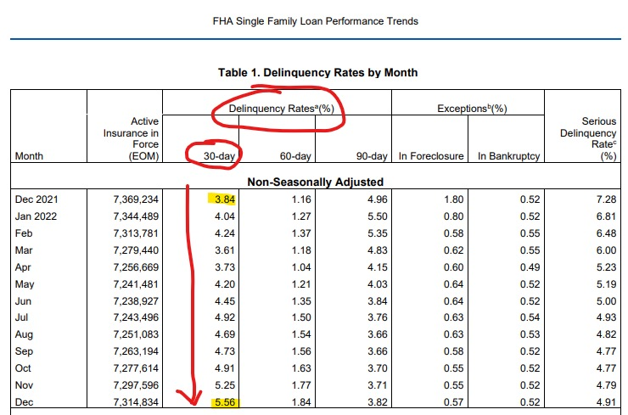

Slide 123
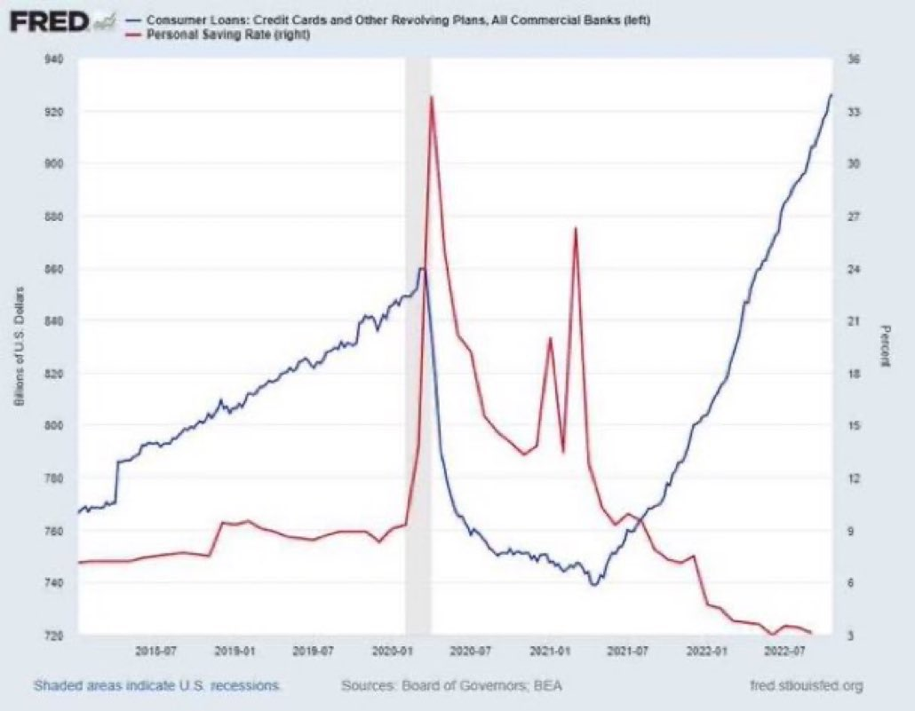

Slide 124
1st Quarter 2023
Broward County
Quarterly Market Report Single Family Detached Residences
RISK ASSESSMENT: Failure to Sell by Price Range
Median of 38.3% is +19.6 points higher than 1Q 2022
Increases in ALL price ranges.
1st Quarter 2023 Metro Market Report Single Family Detached Residences Provided by ChartMaster Services, LLC
124
Notes:
PURPOSE/USE: This chart reflects Failed Listings by price range. This chart can help pinpoint the risk by price point to help sellers make more informed and overall better decisions.
Failed listings (Expired+ Withdrawn) are shown here as a percentage of total “finalized” (Expired + Withdrawn + Closed) listings – (Exp+With)/(Exp+With+Closed)

Slide 125
1st Quarter 2023
Dade County
Quarterly Market Report Single Family Detached Residences
RISK ASSESSMENT: Failure to Sell by Price Range
Median of 45.5% is +18.4 points higher vs. 1Q 2022
Increases in ALL price ranges.
1st Quarter 2023 Metro Market Report Single Family Detached Residences Provided by ChartMaster Services, LLC
125
Notes:
PURPOSE/USE: This chart reflects Failed Listings by price range. This chart can help pinpoint the risk by price point to help sellers make more informed and overall better decisions.
Failed listings (Expired+ Withdrawn) are shown here as a percentage of total “finalized” (Expired + Withdrawn + Closed) listings – (Exp+With)/(Exp+With+Closed)

Slide 126
1st Quarter 2023
Broward County
Quarterly Market Report Condo/Townhome Residences
RISK ASSESSMENT: Failure to Sell
Median of 35.5% is +15.8 points higher vs. 1Q 2022
Increases in ALL price ranges.
1st Quarter 2023 Metro Market Report Condo/Townhouse/Villa Provided by ChartMaster Services, LLC
126
Notes:
PURPOSE/USE: This chart reflects Failed Listings by price range. This chart can help pinpoint the risk by price point to help sellers make more informed and overall better decisions.
Failed listings (Expired+ Withdrawn) are shown here as a percentage of total “finalized” (Expired + Withdrawn + Closed) listings – (Exp+With)/(Exp+With+Closed)

Slide 127
1st Quarter 2023
Dade County
Quarterly Market Report Condo/Townhome Residences
RISK ASSESSMENT: Failure to Sell by Price Range
Median of 46.7% is +16.7 points higher than 1Q 2022
Increases in ALL price ranges.
1st Quarter 2023 Metro Market Report Condo/Townhouse/Villa Provided by ChartMaster Services, LLC
127
Notes:
PURPOSE/USE: This chart reflects Failed Listings by price range. This chart can help pinpoint the risk by price point to help sellers make more informed and overall better decisions.
Failed listings (Expired+ Withdrawn) are shown here as a percentage of total “finalized” (Expired + Withdrawn + Closed) listings – (Exp+With)/(Exp+With+Closed)

Slide 128
1st Quarter 2023
Broward County
Quarterly Market Report Single Family Detached Residences
RISK Assessment: Failure to Sell
38.3% of all Finalized listings failed in 1Q 2023.
Higher by +19.6 percentage points overall vs. 1Q 2022.
1st Quarter 2023 Metro Market Report Single Family Detached Residences Provided by ChartMaster Services, LLC
Back to Table of Contents
128
Notes:
PURPOSE/USE: This chart brings in the other potential outcome of overpricing – Failed Listings. It does this by showing the percentage of Expired and Withdrawn listings (Failed Listings) as a percent of Expired, Withdrawn and Closed listings. These are called Finalized Listings because their status will not change. Think of these as listings rather than a given property itself because an Expired listing could later be re-listed and eventually sell, but during this current period the listing failed to sell and was therefore a Failed Listing. Active and Pending listings are not considered in this calculation because their final conclusion is not yet known. Pending listings don’t always get to closing so they are not included.
This is another measurement relating to the tendency of sellers to overprice their listings. The worst outcome is to not sell at all during the listing period.
Failed listings (Expired+ Withdrawn) are shown here as a percentage of total “finalized” (Expired + Withdrawn + Closed) listings – (Exp+With)/(Exp+With+Closed)

Slide 129
1st Quarter 2023
Dade County
Quarterly Market Report Single Family Detached Residences
RISK Assessment: Failure to Sell
45.5% of all Finalized listings.
1Q 2023: Higher by +18.4 percentage points overall vs. 1Q 2022.
1st Quarter 2023 Metro Market Report Single Family Detached Residences Provided by ChartMaster Services, LLC
Back to Table of Contents
129
Notes:
PURPOSE/USE: This chart brings in the other potential outcome of overpricing – Failed Listings. It does this by showing the percentage of Expired and Withdrawn listings (Failed Listings) as a percent of Expired, Withdrawn and Closed listings. These are called Finalized Listings because their status will not change. Think of these as listings rather than a given property itself because an Expired listing could later be re-listed and eventually sell, but during this current period the listing failed to sell and was therefore a Failed Listing. Active and Pending listings are not considered in this calculation because their final conclusion is not yet known. Pending listings don’t always get to closing so they are not included.
This is another measurement relating to the tendency of sellers to overprice their listings. The worst outcome is to not sell at all during the listing period.
Failed listings (Expired+ Withdrawn) are shown here as a percentage of total “finalized” (Expired + Withdrawn + Closed) listings – (Exp+With)/(Exp+With+Closed)

Slide 130
1st Quarter 2023
Broward County
Quarterly Market Report Condo/Townhome Residences
RISK Assessment: Failure to Sell
35.4% of Finalized listings failed in 1Q 2023.
Higher by +15.8 points overall vs. 1Q 2022.
1st Quarter 2023 Metro Market Report Condo/Townhouse/Villa Provided by ChartMaster Services, LLC
Back to Table of Contents
130
Notes:
PURPOSE/USE: This chart brings in the other potential outcome of overpricing – Failed Listings. It does this by showing the percentage of Expired and Withdrawn listings (Failed Listings) as a percent of Expired, Withdrawn and Closed listings. These are called Finalized Listings because their status will not change. Think of these as listings rather than a given property itself because an Expired listing could later be re-listed and eventually sell, but during this current period the listing failed to sell and was therefore a Failed Listing. Active and Pending listings are not considered in this calculation because their final conclusion is not yet known. Pending listings don’t always get to closing so they are not included.
This is another measurement relating to the tendency of sellers to overprice their listings. The worst outcome is to not sell at all during the listing period.
Failed listings (Expired+ Withdrawn) are shown here as a percentage of total “finalized” (Expired + Withdrawn + Closed) listings – (Exp+With)/(Exp+With+Closed)

Slide 131
1st Quarter 2023
Dade County
Quarterly Market Report Condo/Townhome Residences
RISK Assessment: Failure to Sell
46.7% of all Finalized listings.
1Q 2023: Higher by +16.7 percentage points overall vs. 1Q 2022.
1st Quarter 2023 Metro Market Report Condo/Townhouse/Villa Provided by ChartMaster Services, LLC
Back to Table of Contents
131
Notes:
PURPOSE/USE: This chart brings in the other potential outcome of overpricing – Failed Listings. It does this by showing the percentage of Expired and Withdrawn listings (Failed Listings) as a percent of Expired, Withdrawn and Closed listings. These are called Finalized Listings because their status will not change. Think of these as listings rather than a given property itself because an Expired listing could later be re-listed and eventually sell, but during this current period the listing failed to sell and was therefore a Failed Listing. Active and Pending listings are not considered in this calculation because their final conclusion is not yet known. Pending listings don’t always get to closing so they are not included.
This is another measurement relating to the tendency of sellers to overprice their listings. The worst outcome is to not sell at all during the listing period.
Failed listings (Expired+ Withdrawn) are shown here as a percentage of total “finalized” (Expired + Withdrawn + Closed) listings – (Exp+With)/(Exp+With+Closed)

Slide 132
1st Quarter 2023
Broward-Dade County
Quarterly Market Report
Single Family Detached Residences/
Condo/Townhome Residences
Interactive Charts
4Q 2022 Metro Market Report Single Family Detached Residences/Condo/Townhome Residences
Provided By ChartMaster Services, LLC
1st Quarter 2023 Metro Market Report Single Family Detached Residences / Condo/Townhouse/Villa Provided by ChartMaster Services, LLC
132

Slide 133
1st Quarter 2023
Broward County
Quarterly Market Report Single Family Detached Residences
CUSTOMIZING INSTRUCTIONS: In PowerPoint Normal Mode, double-click anywhere inside the graphic to enter Excel mode. Click in yellow box using down-arrows to select price range and area from dropdown lists and then click twice outside the Excel worksheet to return to PowerPoint mode.
The Real Story
BeachesMLS data for single family Detached residences. Data is believed to be accurate but is not warranted. ©2022 ChartMaster Services, LLC. All rights reserved. This page may not be reproduced without the written permission of JeromyTrask@kw.com.
1st Quarter 2023 Metro Market Report Single Family Detached Residences Provided by ChartMaster Services, LLC
133
Notes:
PURPOSE/USE: This chart is interactive allowing entry of an BeachesMLS area (city) and a Price Range in the 2 boxes at the top of the chart, customizing the quarterly results to those specific entry parameters. This chart has been nicknamed the “Game Board” chart because the object of the game is to get into the “Green Box”, avoiding the “Red Box” and the other impacted results.
We have talked about the effect that price reductions have on seller goals of highest price and shortest time. This chart illustrates that impact, first at the middle tier showing overall price reductions impact. Also, it allows customization to a seller’s likely price range and geographic (BeachesMLS) area.
Then, in the bottom tier, we introduce the multiple listing period impact. ChartMaster stats include DOM and Original Listing Prices for previous listing periods even when the property was off the market for more than 30 days between listings. Normally, BeachesMLS statistics do not include those stats when a listing is withdrawn or Expired and re-listed after a lapse of 30 days or more. Therefore, the median DOM and % S/OLP could be understated by not including all of the information for all listing periods for a given property. Our data attempts to include all relevant listing data.
Additional listing periods dramatically increase the impact when coupled with price reductions. Comparing the possible “Red Box” to “Green Box” outcomes clearly shows that the best strategy for the seller is to initially set a listing price as near as possible to the current market price.
Example: “Would you rather try a higher price and risk selling for -10% less after 4-months, or sell at 100+% in a week?”

Slide 134
1st Quarter 2023
Dade County
Quarterly Market Report Single Family Detached Residences
CUSTOMIZING INSTRUCTIONS: In PowerPoint Normal Mode, double-click anywhere inside the graphic to enter Excel mode. Click in yellow box using down-arrows to select price range and area from dropdown lists and then click twice outside the Excel worksheet to return to PowerPoint mode.
The Real Story
* Medians: Half are higher, and half are lower.
BeachesMLS data for single family Detached residences. Data is believed to be accurate but is not warranted. ©2023 ChartMaster Services, LLC. All rights reserved. This page may not be reproduced without the written permission of JeromyTrask@kw.com.
1st Quarter 2023 Metro Market Report Single Family Detached Residences Provided by ChartMaster Services, LLC
134
Notes:
PURPOSE/USE: This chart is interactive allowing entry of an BeachesMLS area (city) and a Price Range in the 2 boxes at the top of the chart, customizing the quarterly results to those specific entry parameters. This chart has been nicknamed the “Game Board” chart because the object of the game is to get into the “Green Box”, avoiding the “Red Box” and the other impacted results.
We have talked about the effect that price reductions have on seller goals of highest price and shortest time. This chart illustrates that impact, first at the middle tier showing overall price reductions impact. Also, it allows customization to a seller’s likely price range and geographic (BeachesMLS) area.
Then, in the bottom tier, we introduce the multiple listing period impact. ChartMaster stats include DOM and Original Listing Prices for previous listing periods even when the property was off the market for more than 30 days between listings. Normally, BeachesMLS statistics do not include those stats when a listing is Withdrawn or Expired and re-listed after a lapse of 30 days or more. Therefore, the median DOM and % S/OLP could be understated by not including all of the information for all listing periods for a given property. Our data attempts to include all relevant listing data.
Additional listing periods dramatically increase the impact when coupled with price reductions. Comparing the possible “Red Box” to “Green Box” outcomes clearly shows that the best strategy for the seller is to initially set a listing price as near as possible to the current market price.
Example: “Would you rather try a higher price and risk selling for -10% less after 4-months, or sell at 100+% in a week?”

Slide 135
1st Quarter 2023
Broward County
Quarterly Market Report Condo/Townhome Residences
CUSTOMIZING INSTRUCTIONS: In PowerPoint Normal Mode, double-click anywhere inside the graphic to enter Excel mode. Click in yellow box using down-arrows to select price range and area from dropdown lists and then click twice outside the Excel worksheet to return to PowerPoint mode.
The Real Story
BeachesMLS data for single family Condo/Townhouse/Villa residences. Data is believed to be accurate but is not warranted. ©2023 ChartMaster Services, LLC. All rights reserved. This page may not be reproduced without the written permission of JeromyTrask@kw.com.
1st Quarter 2023 Metro Market Report Condo/Townhouse/Villa Provided by ChartMaster Services, LLC
135
Notes:
PURPOSE/USE: This chart is interactive allowing entry of an BeachesMLS area (city) and a Price Range in the 2 boxes at the top of the chart, customizing the quarterly results to those specific entry parameters. This chart has been nicknamed the “Game Board” chart because the object of the game is to get into the “Green Box”, avoiding the “Red Box” and the other impacted results.
We have talked about the effect that price reductions have on seller goals of highest price and shortest time. This chart illustrates that impact, first at the middle tier showing overall price reductions impact. Also, it allows customization to a seller’s likely price range and geographic (BeachesMLS) area.
Then, in the bottom tier, we introduce the multiple listing period impact. ChartMaster stats include DOM and Original Listing Prices for previous listing periods even when the property was off the market for more than 30 days between listings. Normally, BeachesMLS statistics do not include those stats when a listing is withdrawn or Expired and re-listed after a lapse of 30 days or more. Therefore, the median DOM and % S/OLP could be understated by not including all of the information for all listing periods for a given property. Our data attempts to include all relevant listing data.
Additional listing periods dramatically increase the impact when coupled with price reductions. Comparing the possible “Red Box” to “Green Box” outcomes clearly shows that the best strategy for the seller is to initially set a listing price as near as possible to the current market price.
Example: “Would you rather try a higher price and risk selling for -10% less after 4-months, or sell at 100+% in a week?”

Slide 136
1st Quarter 2023
Dade County
Quarterly Market Report Condo/Townhome Residences
CUSTOMIZING INSTRUCTIONS: In PowerPoint Normal Mode, double-click anywhere inside the graphic to enter Excel mode. Click in yellow box using down-arrows to select price range and area from dropdown lists and then click twice outside the Excel worksheet to return to PowerPoint mode.
The Real Story
* Medians: Half are higher, and half are lower.
BeachesMLS data for single family Condo/Townhouse/Villa residences. Data is believed to be accurate but is not warranted. ©2023 ChartMaster Services, LLC. All rights reserved. This page may not be reproduced without the written permission of JeromyTrask@kw.com.
1st Quarter 2023 Metro Market Report Condo/Townhouse/Villa Provided by ChartMaster Services, LLC
136
Notes:
PURPOSE/USE: This chart is interactive allowing entry of an BeachesMLS area (city) and a Price Range in the 2 boxes at the top of the chart, customizing the quarterly results to those specific entry parameters. This chart has been nicknamed the “Game Board” chart because the object of the game is to get into the “Green Box”, avoiding the “Red Box” and the other impacted results.
We have talked about the effect that price reductions have on seller goals of highest price and shortest time. This chart illustrates that impact, first at the middle tier showing overall price reductions impact. Also, it allows customization to a seller’s likely price range and geographic (BeachesMLS) area.
Then, in the bottom tier, we introduce the multiple listing period impact. ChartMaster stats include DOM and Original Listing Prices for previous listing periods even when the property was off the market for more than 30 days between listings. Normally, BeachesMLS statistics do not include those stats when a listing is Withdrawn or Expired and re-listed after a lapse of 30 days or more. Therefore, the median DOM and % S/OLP could be understated by not including all of the information for all listing periods for a given property. Our data attempts to include all relevant listing data.
Additional listing periods dramatically increase the impact when coupled with price reductions. Comparing the possible “Red Box” to “Green Box” outcomes clearly shows that the best strategy for the seller is to initially set a listing price as near as possible to the current market price.
Example: “Would you rather try a higher price and risk selling for -10% less after 4-months, or sell at 100+% in a week?”

Slide 137
1st Quarter 2023
Broward County
Quarterly Market Report Single Family Detached Residences
CUSTOMIZING INSTRUCTIONS: In PowerPoint Normal Mode, double-click anywhere inside the chart to enter Excel mode. Click in yellow box using down-arrows to select price range and area from dropdown lists and then click twice outside the Excel worksheet to return to PowerPoint mode.
Outcomes in Your Price Range and Geographic area
BeachesMLS data for single family Detached residences. Data is believed to be accurate but is not warranted. ©2022 ChartMaster Services, LLC. All rights reserved. This page may not be reproduced without the written permission of JeromyTrask@kw.com.
1st Quarter 2023 Metro Market Report Single Family Detached Residences Provided by ChartMaster Services, LLC
137
Notes:
PURPOSE/USE: The use of this chart is to apply the most recent market data to the seller’s situation in terms of price range and BeachesMLS area. It puts together the concepts and data for “Failed listings” (Expired or Withdrawn), price reduced listings and correctly priced listings to illustrate that a very large percentage of listings in the recent period were at least initially overpriced. The results of that overpricing were either being rejected by the market or selling at a much-reduced price in a much longer time on market. Thereby failing to achieve the results of getting the highest price in the shortest time on market.
Even if the “Green Box” percentage appears relatively high, it is the percentage of only the properties that sold during the period, not including those that failed to sell. Adding those that failed and using the percentage of total finalized listings as presented in the two bottom boxes puts a more realistic perspective on the likely outcomes of overpricing.
Always try interactive numbers before seeing a client in order to avoid any possible surprises that may come with price range/area combinations which result in very few listings. Few listings meeting the criteria can result in results too small to be reliable.

Slide 138
1st Quarter 2023
Dade County
Quarterly Market Report Single Family Detached Residences
CUSTOMIZING INSTRUCTIONS: In PowerPoint Normal Mode, double-click anywhere inside the chart to enter Excel mode. Click in yellow box using down-arrows to select price range, then area from dropdown lists and then click twice outside the Excel worksheet to return to PowerPoint mode.
Outcomes in Your Price Range and Geographic area
BeachesMLS data for single family Detached residences. Data is believed to be accurate but is not warranted. ©2023 ChartMaster Services, LLC. All rights reserved. This page may not be reproduced without the written permission of JeromyTrask@kw.com.
1st Quarter 2023 Metro Market Report Single Family Detached Residences Provided by ChartMaster Services, LLC
138
Notes:
PURPOSE/USE: The use of this chart is to apply the most recent market data to the seller’s situation in terms of price range and BeachesMLS area. It puts together the concepts and data for “Failed listings” (Expired or Withdrawn), price reduced listings and correctly priced listings to illustrate that a very large percentage of listings in the recent period were at least initially overpriced. The results of that overpricing were either being rejected by the market or selling at a much-reduced price in a much longer time on market. Thereby failing to achieve the results of getting the highest price in the shortest time on market.
Even if the “Green Box” percentage appears relatively high, it is the percentage of only the properties that sold during the period, not including those that failed to sell. Adding those that failed and using the percentage of total finalized listings as presented in the two bottom boxes puts a more realistic perspective on the likely outcomes of overpricing.
Always try interactive numbers before seeing a client in order to avoid any possible surprises that may come with price range/area combinations which result in very few listings. Few listings meeting the criteria can result in results too small to be reliable.

Slide 139
1st Quarter 2023
Broward County
Quarterly Market Report Condo/Townhome Residences
CUSTOMIZING INSTRUCTIONS: In PowerPoint Normal Mode, double-click anywhere inside the chart to enter Excel mode. Click in yellow box using down-arrows to select price range, then area from dropdown lists and then click twice outside the Excel worksheet to return to PowerPoint mode.
Outcomes in Your Price Range and Geographic area
BeachesMLS data for single family Condo/Townhouse/Villa residences. Data is believed to be accurate but is not warranted. ©2023 ChartMaster Services, LLC. All rights reserved. This page may not be reproduced without the written permission of JeromyTrask@kw.com.
1st Quarter 2023 Metro Market Report Condo/Townhouse/Villa Provided by ChartMaster Services, LLC
139
Notes:
PURPOSE/USE: The use of this chart is to apply the most recent market data to the seller’s situation in terms of price range and BeachesMLS area. It puts together the concepts and data for “Failed listings” (Expired or Withdrawn), price reduced listings and correctly priced listings to illustrate that a very large percentage of listings in the recent period were at least initially overpriced. The results of that overpricing were either being rejected by the market or selling at a much-reduced price in a much longer time on market. Thereby failing to achieve the results of getting the highest price in the shortest time on market.
Even if the “Green Box” percentage appears relatively high, it is the percentage of only the properties that sold during the period, not including those that failed to sell. Adding those that failed and using the percentage of total finalized listings as presented in the two bottom boxes puts a more realistic perspective on the likely outcomes of overpricing.
Always try interactive numbers before seeing a client in order to avoid any possible surprises that may come with price range/area combinations which result in very few listings. Few listings meeting the criteria can result in results too small to be reliable.

Slide 140
1st Quarter 2023
Dade County
Quarterly Market Report Condo/Townhome Residences
CUSTOMIZING INSTRUCTIONS: In PowerPoint Normal Mode, double-click anywhere inside the chart to enter Excel mode. Click in yellow box using down-arrows to select price range, then area from dropdown lists and then click twice outside the Excel worksheet to return to PowerPoint mode.
Outcomes in Your Price Range and Geographic area
BeachesMLS data for single family Condo/Townhouse/Villa residences. Data is believed to be accurate but is not warranted. ©2023 ChartMaster Services, LLC. All rights reserved. This page may not be reproduced without the written permission of JeromyTrask@kw.com.
1st Quarter 2023 Metro Market Report Condo/Townhouse/Villa Provided by ChartMaster Services, LLC
140
Notes:
PURPOSE/USE: The use of this chart is to apply the most recent market data to the seller’s situation in terms of price range and BeachesMLS area. It puts together the concepts and data for “Failed listings” (Expired or Withdrawn), price reduced listings and correctly priced listings to illustrate that a very large percentage of listings in the recent period were at least initially overpriced. The results of that overpricing were either being rejected by the market or selling at a much-reduced price in a much longer time on market. Thereby failing to achieve the results of getting the highest price in the shortest time on market.
Even if the “Green Box” percentage appears relatively high, it is the percentage of only the properties that sold during the period, not including those that failed to sell. Adding those that failed and using the percentage of total finalized listings as presented in the two bottom boxes puts a more realistic perspective on the likely outcomes of overpricing.
Always try interactive numbers before seeing a client in order to avoid any possible surprises that may come with price range/area combinations which result in very few listings. Few listings meeting the criteria can result in results too small to be reliable.

Slide 141
1st Quarter 2023
Dade County
Quarterly Market Report Single Family Detached Residences
CUSTOMIZING INSTRUCTIONS: In PowerPoint Normal Mode, double-click anywhere inside the graphic to enter Excel mode. Choose the dropdown area and then in the yellow boxes enter prices and carrying costs, then click twice outside the Excel worksheet to return to PowerPoint mode.
BeachesMLS data for single family Detached residences. Data is believed to be accurate but is not warranted. ©2023 ChartMaster Services, LLC. All rights reserved. This page may not be reproduced without the written permission of JeromyTrask@kw.com.
1st Quarter 2023 Metro Market Report Single Family Detached Residences Provided by ChartMaster Services, LLC
Back to Table of Contents
141
Notes:
PURPOSE/USE: We suggest that you review your CMA before using this chart. It illustrates the concepts presented in realistic terms to a seller by using your suggested listing price compared to a strategy of pricing higher to leave room for negotiations. These percentages are medians for transactions in the most recent reporting period and are not guarantees to the seller that their transaction will follow this path. It is an illustration of what did happen in this recent period across thousands of transactions in the selected 33 Cities of Metro Miami-Dade County and therefore should instill greater confidence that these results are likely and reasonable. The numbers used are those of the bottom tier of the game board graphic, illustrating what could happen if there was both a price reduction and multiple listing periods.
Even if there is total agreement between you and the seller, it would be good to show them what the results would likely be for them to price higher. The chart is interactive allowing you to enter the “Desired” price, “Suggested” price and carrying costs. The percentages used in this exercise are from the bottom tier of the “Game Board” chart showing the worst-case scenario. Once a property is overpriced, you have no way of knowing whether it will adjust quickly or chase the market, so the greatest likely risk should be considered.
Always be sure to try numbers that are likely to result before seeing your client since combinations resulting in a small number of closings can sometimes not fit with the overall medians and create misunderstandings of the implications.

Slide 142
1st Quarter 2023
Broward County
Quarterly Market Report Condo/Townhome Residences
CUSTOMIZING INSTRUCTIONS: In PowerPoint Normal Mode, double-click anywhere inside the graphic to enter Excel mode. Choose the dropdown area and then in the yellow boxes enter prices and carrying costs, then click twice outside the Excel worksheet to return to PowerPoint mode.
BeachesMLS data for single family Condo/Townhouse/Villa residences. Data is believed to be accurate but is not warranted. ©2023 ChartMaster Services, LLC. All rights reserved. This page may not be reproduced without the written permission of JeromyTrask@kw.com.
1st Quarter 2023 Metro Market Report Condo/Townhouse/Villa Provided by ChartMaster Services, LLC
Back to Table of Contents
142
Notes:
PURPOSE/USE: We suggest that you review your CMA before using this chart. It illustrates the concepts presented in realistic terms to a seller by using your suggested listing price compared to a strategy of pricing higher to leave room for negotiations. These percentages are medians for transactions in the most recent reporting period and are not guarantees to the seller that their transaction will follow this path. It is an illustration of what did happen in this recent period across thousands of transactions in the selected 21 Cities of Metro Broward County and therefore should instill greater confidence that these results are likely and reasonable. The numbers used are those of the bottom tier of the game board graphic, illustrating what could happen if there was both a price reduction and multiple listing periods.
Even if there is total agreement between you and the seller, it would be good to show them what the results would likely be for them to price higher. The chart is interactive allowing you to enter the “Desired” price, “Suggested” price and carrying costs. The percentages used in this exercise are from the bottom tier of the “Game Board” chart showing the worst-case scenario. Once a property is overpriced, you have no way of knowing whether it will adjust quickly or chase the market, so the greatest likely risk should be considered.
Always be sure to try numbers that are likely to result before seeing your client since combinations resulting in a small number of closings can sometimes not fit with the overall medians and create misunderstandings of the implications.

Slide 143
1st Quarter 2023
Dade County
Quarterly Market Report Condo/Townhome Residences
CUSTOMIZING INSTRUCTIONS: In PowerPoint Normal Mode, double-click anywhere inside the graphic to enter Excel mode. Choose the dropdown area and then in the yellow boxes enter prices and carrying costs, then click twice outside the Excel worksheet to return to PowerPoint mode.
BeachesMLS data for single family Condo/Townhouse/Villa residences. Data is believed to be accurate but is not warranted. ©2023 ChartMaster Services, LLC. All rights reserved. This page may not be reproduced without the written permission of JeromyTrask@kw.com.
1st Quarter 2023 Metro Market Report Condo/Townhouse/Villa Provided by ChartMaster Services, LLC
Back to Table of Contents
143
Notes:
PURPOSE/USE: We suggest that you review your CMA before using this chart. It illustrates the concepts presented in realistic terms to a seller by using your suggested listing price compared to a strategy of pricing higher to leave room for negotiations. These percentages are medians for transactions in the most recent reporting period and are not guarantees to the seller that their transaction will follow this path. It is an illustration of what did happen in this recent period across thousands of transactions in the selected 33 Cities of Metro Miami-Dade County and therefore should instill greater confidence that these results are likely and reasonable. The numbers used are those of the bottom tier of the game board graphic, illustrating what could happen if there was both a price reduction and multiple listing periods.
Even if there is total agreement between you and the seller, it would be good to show them what the results would likely be for them to price higher. The chart is interactive allowing you to enter the “Desired” price, “Suggested” price and carrying costs. The percentages used in this exercise are from the bottom tier of the “Game Board” chart showing the worst-case scenario. Once a property is overpriced, you have no way of knowing whether it will adjust quickly or chase the market, so the greatest likely risk should be considered.
Always be sure to try numbers that are likely to result before seeing your client since combinations resulting in a small number of closings can sometimes not fit with the overall medians and create misunderstandings of the implications.

Slide 144
1st Quarter 2023
Broward County
Quarterly Market Report Single Family Detached Residences
Up by +2.0 months to 3.0 months overall vs. 1Q 2022
Sales priced above $2M had the biggest increase and moved into a Buyer’s Market condition.
All price ranges below $2M are still in a Seller’s Market condition.
1st Quarter 2023 Metro Market Report Single Family Detached Residences Provided by ChartMaster Services, LLC
144
Notes:
PURPOSE/USE: Use to position a particular property by price range for more relevant comparison to same period last year. Also illustrates the differences by price range, particularly as price ranges become higher.

Slide 145
1st Quarter 2023
Dade County
Quarterly Market Report Single Family Detached Residences
Up by +2.3 Months (+135.3%) Overall vs. 1Q 2022
Sales priced above $1M moved into a Buyer’s Market
Increased in 7 of 8 price ranges.
1st Quarter 2023 Metro Market Report Single Family Detached Residences Provided by ChartMaster Services, LLC
145
Notes:
PURPOSE/USE: Use to position a particular property by price range for more relevant comparison to same period last year. Also illustrates the differences by price range, particularly as price ranges become higher.

Slide 146
1st Quarter 2023
Broward County
Quarterly Market Report Condo/Townhome Residences
Overall, Supply up +2.5 months to 3.7 months vs. 1Q 2022
Homes priced above $750k have moved back into a Buyer’s Market.
All price ranges below $750k still in a Seller’s Market.
1st Quarter 2023 Metro Market Report Condo/Townhouse/Villa Provided by ChartMaster Services, LLC
146
Notes:
PURPOSE/USE: Use to position a particular property by price range for more relevant comparison to same period last year. Also illustrates the differences by price range, particularly as price ranges become higher.

Slide 147
1st Quarter 2023
Dade County
Quarterly Market Report Condo/Townhome Residences
Up by +4.0 Months (+190.5%) Overall vs. 1Q 2022
Sales priced above $750k are in a Buyer’s Market.
Increases in ALL price ranges.
1st Quarter 2023 Metro Market Report Condo/Townhouse/Villa Provided by ChartMaster Services, LLC
147
Notes:
PURPOSE/USE: Use to position a particular property by price range for more relevant comparison to same period last year. Also illustrates the differences by price range, particularly as price ranges become higher.

